Slide 1
JVM

Slide 2

Write
Demo.java
javac
javap
A.class
B.class
Demo.class
java
jar
JAR: Java Archive File
JVM: Java Virtual Machine
java
Demo.jar
JVM

Slide 3




Demo.jar
JVM Level
Windows JVM
Linux JVM
MAC JVM
Android JVM
OS Level

Slide 4
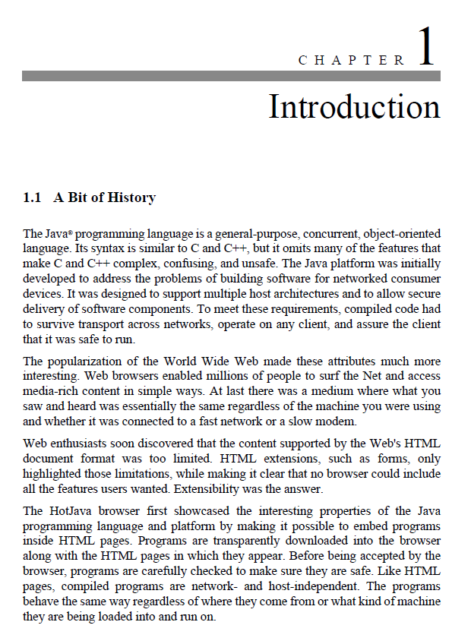
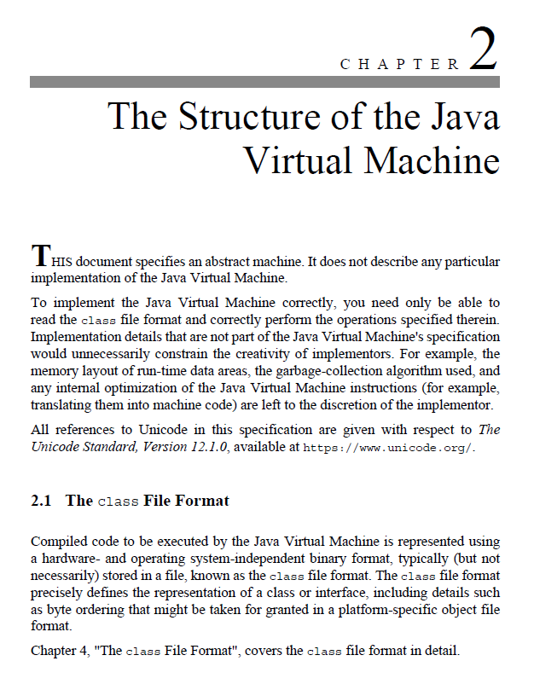
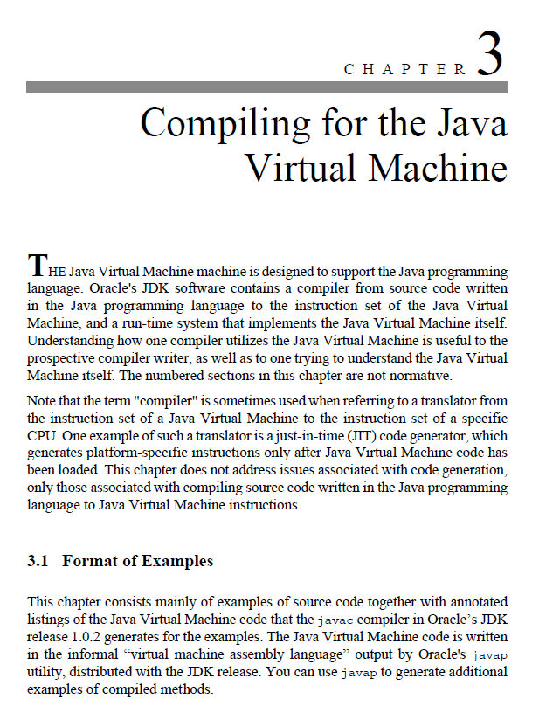
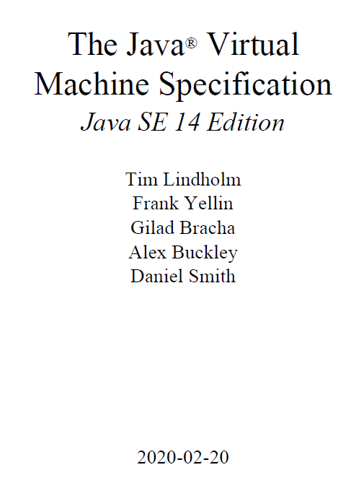
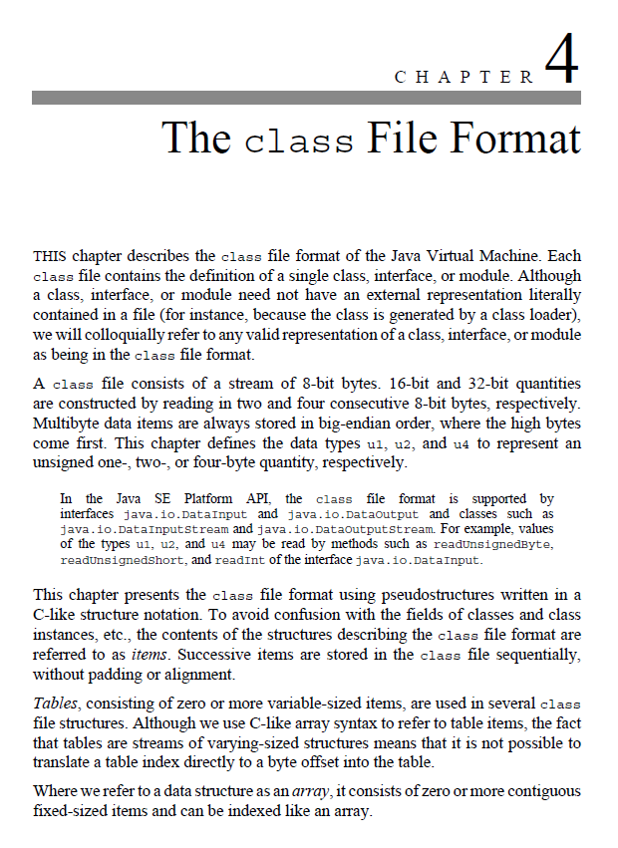
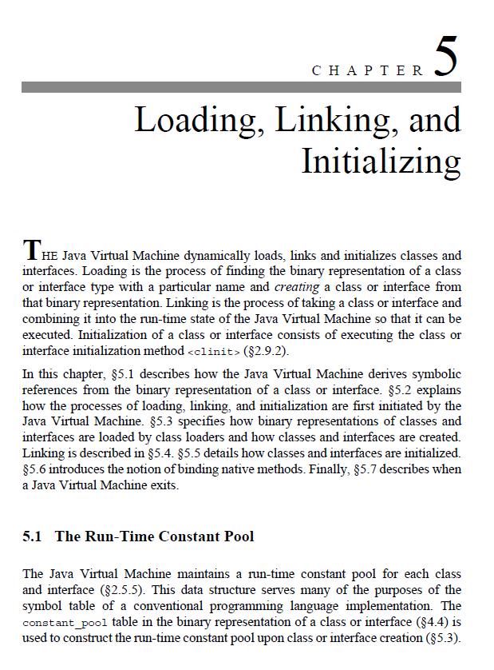
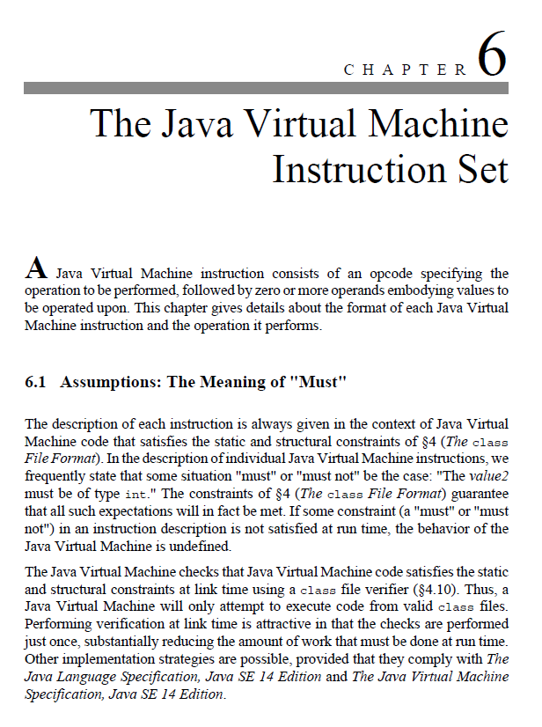
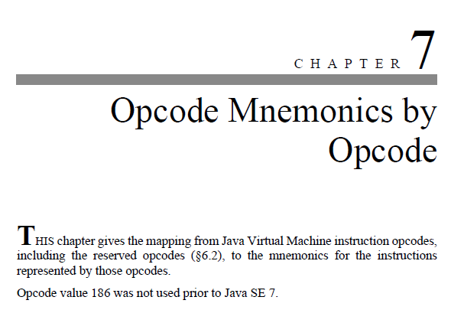

Slide 5
Overview

Slide 6
ca | fe | ba | be | 00 | 00 | 00 | 3a | 00 | 14 | 0a | 00 | 02 | 00 | 03 | 07
00 | 04 | 0c | 00 | 05 | 00 | 06 | 01 | 00 | 10 | 6a | 61 | 76 | 61 | 2f | 6c
61 | 6e | 67 | 2f | 4f | 62 | 6a | 65 | 63 | 74 | 01 | 00 | 06 | 3c | 69 | 6e
69 | 74 | 3e | 01 | 00 | 03 | 28 | 29 | 56 | 09 | 00 | 08 | 00 | 09 | 07 | 00
0a | 0c | 00 | 0b | 00 | 0c | 01 | 00 | 04 | 44 | 65 | 6d | 6f | 01 | 00 | 01
6e | 01 | 00 | 01 | 49 | 01 | 00 | 04 | 43 | 6f | 64 | 65 | 01 | 00 | 0f | 4c
69 | 6e | 65 | 4e | 75 | 6d | 62 | 65 | 72 | 54 | 61 | 62 | 6c | 65 | 01 | 00
03 | 61 | 64 | 64 | 01 | 00 | 05 | 28 | 49 | 49 | 29 | 49 | 01 | 00 | 05 | 6d
69 | 6e | 75 | 73 | 01 | 00 | 0a | 53 | 6f | 75 | 72 | 63 | 65 | 46 | 69 | 6c
65 | 01 | 00 | 09 | 44 | 65 | 6d | 6f | 2e | 6a | 61 | 76 | 61 | 00 | 21 | 00
08 | 00 | 02 | 00 | 00 | 00 | 01 | 00 | 02 | 00 | 0b | 00 | 0c | 00 | 00 | 00
03 | 00 | 01 | 00 | 05 | 00 | 06 | 00 | 01 | 00 | 0d | 00 | 00 | 00 | 26 | 00
02 | 00 | 01 | 00 | 00 | 00 | 0a | 2a | b7 | 00 | 01 | 2a | 08 | b5 | 00 | 07
b1 | 00 | 00 | 00 | 01 | 00 | 0e | 00 | 00 | 00 | 0a | 00 | 02 | 00 | 00 | 00
01 | 00 | 04 | 00 | 02 | 00 | 02 | 00 | 0f | 00 | 10 | 00 | 01 | 00 | 0d | 00
00 | 00 | 22 | 00 | 02 | 00 | 04 | 00 | 00 | 00 | 06 | 1b | 1c | 60 | 3e | 1d
ac | 00 | 00 | 00 | 01 | 00 | 0e | 00 | 00 | 00 | 0a | 00 | 02 | 00 | 00 | 00
05 | 00 | 04 | 00 | 06 | 00 | 04 | 00 | 11 | 00 | 10 | 00 | 01 | 00 | 0d | 00
00 | 00 | 22 | 00 | 02 | 00 | 04 | 00 | 00 | 00 | 06 | 1b | 1c | 64 | 3e | 1d
ac | 00 | 00 | 00 | 01 | 00 | 0e | 00 | 00 | 00 | 0a | 00 | 02 | 00 | 00 | 00
0a | 00 | 04 | 00 | 0b | 00 | 01 | 00 | 12 | 00 | 00 | 00 | 02 | 00 | 13 | 0a
Magic | Version
Constant Pool | 0c | 00
 | Access Flags | This Class
Super Class | Interfaces | Fields
Methods
 | Attributes | Attributres

Slide 7
Magic

Slide 8

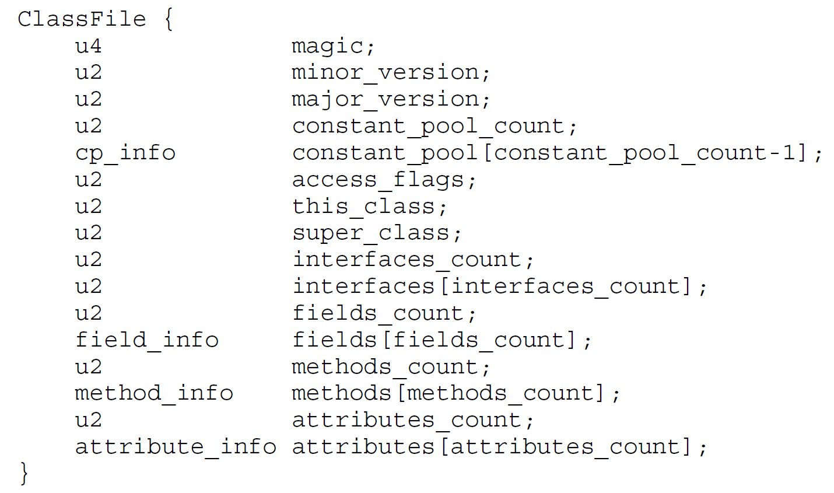
ca | fe | ba | be | 00 | 00 | 00 | 3a | 00 | 14 | 0a | 00 | 02 | 00 | 03 | 07
00 | 04 | 0c | 00 | 05 | 00 | 06 | 01 | 00 | 10 | 6a | 61 | 76 | 61 | 2f | 6c
61 | 6e | 67 | 2f | 4f | 62 | 6a | 65 | 63 | 74 | 01 | 00 | 06 | 3c | 69 | 6e
69 | 74 | 3e | 01 | 00 | 03 | 28 | 29 | 56 | 09 | 00 | 08 | 00 | 09 | 07 | 00
0a | 0c | 00 | 0b | 00 | 0c | 01 | 00 | 04 | 44 | 65 | 6d | 6f | 01 | 00 | 01
6e | 01 | 00 | 01 | 49 | 01 | 00 | 04 | 43 | 6f | 64 | 65 | 01 | 00 | 0f | 4c
69 | 6e | 65 | 4e | 75 | 6d | 62 | 65 | 72 | 54 | 61 | 62 | 6c | 65 | 01 | 00
03 | 61 | 64 | 64 | 01 | 00 | 05 | 28 | 49 | 49 | 29 | 49 | 01 | 00 | 05 | 6d
69 | 6e | 75 | 73 | 01 | 00 | 0a | 53 | 6f | 75 | 72 | 63 | 65 | 46 | 69 | 6c
65 | 01 | 00 | 09 | 44 | 65 | 6d | 6f | 2e | 6a | 61 | 76 | 61 | 00 | 21 | 00
08 | 00 | 02 | 00 | 00 | 00 | 01 | 00 | 02 | 00 | 0b | 00 | 0c | 00 | 00 | 00
03 | 00 | 01 | 00 | 05 | 00 | 06 | 00 | 01 | 00 | 0d | 00 | 00 | 00 | 26 | 00
02 | 00 | 01 | 00 | 00 | 00 | 0a | 2a | b7 | 00 | 01 | 2a | 08 | b5 | 00 | 07
b1 | 00 | 00 | 00 | 01 | 00 | 0e | 00 | 00 | 00 | 0a | 00 | 02 | 00 | 00 | 00
01 | 00 | 04 | 00 | 02 | 00 | 02 | 00 | 0f | 00 | 10 | 00 | 01 | 00 | 0d | 00
00 | 00 | 22 | 00 | 02 | 00 | 04 | 00 | 00 | 00 | 06 | 1b | 1c | 60 | 3e | 1d
ac | 00 | 00 | 00 | 01 | 00 | 0e | 00 | 00 | 00 | 0a | 00 | 02 | 00 | 00 | 00
05 | 00 | 04 | 00 | 06 | 00 | 04 | 00 | 11 | 00 | 10 | 00 | 01 | 00 | 0d | 00
00 | 00 | 22 | 00 | 02 | 00 | 04 | 00 | 00 | 00 | 06 | 1b | 1c | 64 | 3e | 1d
ac | 00 | 00 | 00 | 01 | 00 | 0e | 00 | 00 | 00 | 0a | 00 | 02 | 00 | 00 | 00
0a | 00 | 04 | 00 | 0b | 00 | 01 | 00 | 12 | 00 | 00 | 00 | 02 | 00 | 13 | 0a
Magic
Magic: 0xCAFEBABE

Slide 9
Version

Slide 10
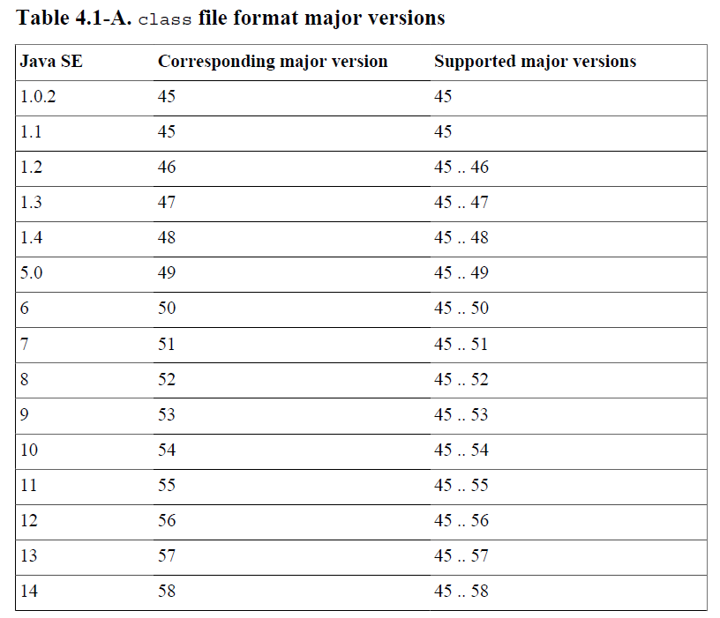
ca | fe | ba | be | 00 | 00 | 00 | 3a | 00 | 14 | 0a | 00 | 02 | 00 | 03 | 07
00 | 04 | 0c | 00 | 05 | 00 | 06 | 01 | 00 | 10 | 6a | 61 | 76 | 61 | 2f | 6c
61 | 6e | 67 | 2f | 4f | 62 | 6a | 65 | 63 | 74 | 01 | 00 | 06 | 3c | 69 | 6e
69 | 74 | 3e | 01 | 00 | 03 | 28 | 29 | 56 | 09 | 00 | 08 | 00 | 09 | 07 | 00
0a | 0c | 00 | 0b | 00 | 0c | 01 | 00 | 04 | 44 | 65 | 6d | 6f | 01 | 00 | 01
6e | 01 | 00 | 01 | 49 | 01 | 00 | 04 | 43 | 6f | 64 | 65 | 01 | 00 | 0f | 4c
69 | 6e | 65 | 4e | 75 | 6d | 62 | 65 | 72 | 54 | 61 | 62 | 6c | 65 | 01 | 00
03 | 61 | 64 | 64 | 01 | 00 | 05 | 28 | 49 | 49 | 29 | 49 | 01 | 00 | 05 | 6d
69 | 6e | 75 | 73 | 01 | 00 | 0a | 53 | 6f | 75 | 72 | 63 | 65 | 46 | 69 | 6c
65 | 01 | 00 | 09 | 44 | 65 | 6d | 6f | 2e | 6a | 61 | 76 | 61 | 00 | 21 | 00
08 | 00 | 02 | 00 | 00 | 00 | 01 | 00 | 02 | 00 | 0b | 00 | 0c | 00 | 00 | 00
03 | 00 | 01 | 00 | 05 | 00 | 06 | 00 | 01 | 00 | 0d | 00 | 00 | 00 | 26 | 00
02 | 00 | 01 | 00 | 00 | 00 | 0a | 2a | b7 | 00 | 01 | 2a | 08 | b5 | 00 | 07
b1 | 00 | 00 | 00 | 01 | 00 | 0e | 00 | 00 | 00 | 0a | 00 | 02 | 00 | 00 | 00
01 | 00 | 04 | 00 | 02 | 00 | 02 | 00 | 0f | 00 | 10 | 00 | 01 | 00 | 0d | 00
00 | 00 | 22 | 00 | 02 | 00 | 04 | 00 | 00 | 00 | 06 | 1b | 1c | 60 | 3e | 1d
ac | 00 | 00 | 00 | 01 | 00 | 0e | 00 | 00 | 00 | 0a | 00 | 02 | 00 | 00 | 00
05 | 00 | 04 | 00 | 06 | 00 | 04 | 00 | 11 | 00 | 10 | 00 | 01 | 00 | 0d | 00
00 | 00 | 22 | 00 | 02 | 00 | 04 | 00 | 00 | 00 | 06 | 1b | 1c | 64 | 3e | 1d
ac | 00 | 00 | 00 | 01 | 00 | 0e | 00 | 00 | 00 | 0a | 00 | 02 | 00 | 00 | 00
0a | 00 | 04 | 00 | 0b | 00 | 01 | 00 | 12 | 00 | 00 | 00 | 02 | 00 | 13 | 0a
Version
Minor Version: 0x0000 = 0
Major Version: 0x003a = 58

Slide 11
Constant
Pool

Slide 12
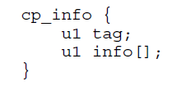
ca | fe | ba | be | 00 | 00 | 00 | 3a | 00 | 14 | 0a | 00 | 02 | 00 | 03 | 07
00 | 04 | 0c | 00 | 05 | 00 | 06 | 01 | 00 | 10 | 6a | 61 | 76 | 61 | 2f | 6c
61 | 6e | 67 | 2f | 4f | 62 | 6a | 65 | 63 | 74 | 01 | 00 | 06 | 3c | 69 | 6e
69 | 74 | 3e | 01 | 00 | 03 | 28 | 29 | 56 | 09 | 00 | 08 | 00 | 09 | 07 | 00
0a | 0c | 00 | 0b | 00 | 0c | 01 | 00 | 04 | 44 | 65 | 6d | 6f | 01 | 00 | 01
6e | 01 | 00 | 01 | 49 | 01 | 00 | 04 | 43 | 6f | 64 | 65 | 01 | 00 | 0f | 4c
69 | 6e | 65 | 4e | 75 | 6d | 62 | 65 | 72 | 54 | 61 | 62 | 6c | 65 | 01 | 00
03 | 61 | 64 | 64 | 01 | 00 | 05 | 28 | 49 | 49 | 29 | 49 | 01 | 00 | 05 | 6d
69 | 6e | 75 | 73 | 01 | 00 | 0a | 53 | 6f | 75 | 72 | 63 | 65 | 46 | 69 | 6c
65 | 01 | 00 | 09 | 44 | 65 | 6d | 6f | 2e | 6a | 61 | 76 | 61 | 00 | 21 | 00
08 | 00 | 02 | 00 | 00 | 00 | 01 | 00 | 02 | 00 | 0b | 00 | 0c | 00 | 00 | 00
03 | 00 | 01 | 00 | 05 | 00 | 06 | 00 | 01 | 00 | 0d | 00 | 00 | 00 | 26 | 00
02 | 00 | 01 | 00 | 00 | 00 | 0a | 2a | b7 | 00 | 01 | 2a | 08 | b5 | 00 | 07
b1 | 00 | 00 | 00 | 01 | 00 | 0e | 00 | 00 | 00 | 0a | 00 | 02 | 00 | 00 | 00
01 | 00 | 04 | 00 | 02 | 00 | 02 | 00 | 0f | 00 | 10 | 00 | 01 | 00 | 0d | 00
00 | 00 | 22 | 00 | 02 | 00 | 04 | 00 | 00 | 00 | 06 | 1b | 1c | 60 | 3e | 1d
ac | 00 | 00 | 00 | 01 | 00 | 0e | 00 | 00 | 00 | 0a | 00 | 02 | 00 | 00 | 00
05 | 00 | 04 | 00 | 06 | 00 | 04 | 00 | 11 | 00 | 10 | 00 | 01 | 00 | 0d | 00
00 | 00 | 22 | 00 | 02 | 00 | 04 | 00 | 00 | 00 | 06 | 1b | 1c | 64 | 3e | 1d
ac | 00 | 00 | 00 | 01 | 00 | 0e | 00 | 00 | 00 | 0a | 00 | 02 | 00 | 00 | 00
0a | 00 | 04 | 00 | 0b | 00 | 01 | 00 | 12 | 00 | 00 | 00 | 02 | 00 | 13 | 0a
Constant Pool
Constant Pool Count: 0x0014 = 20

Slide 13
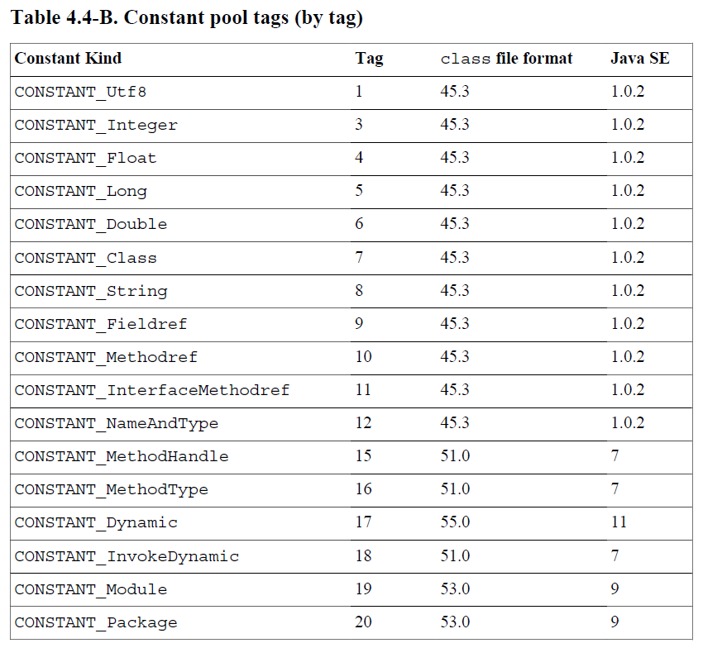
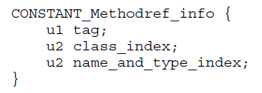
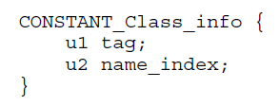
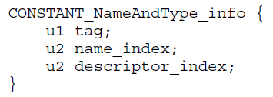
ca | fe | ba | be | 00 | 00 | 00 | 3a | 00 | 14 | 0a | 00 | 02 | 00 | 03 | 07
00 | 04 | 0c | 00 | 05 | 00 | 06 | 01 | 00 | 10 | 6a | 61 | 76 | 61 | 2f | 6c
61 | 6e | 67 | 2f | 4f | 62 | 6a | 65 | 63 | 74 | 01 | 00 | 06 | 3c | 69 | 6e
69 | 74 | 3e | 01 | 00 | 03 | 28 | 29 | 56 | 09 | 00 | 08 | 00 | 09 | 07 | 00
0a | 0c | 00 | 0b | 00 | 0c | 01 | 00 | 04 | 44 | 65 | 6d | 6f | 01 | 00 | 01
6e | 01 | 00 | 01 | 49 | 01 | 00 | 04 | 43 | 6f | 64 | 65 | 01 | 00 | 0f | 4c
69 | 6e | 65 | 4e | 75 | 6d | 62 | 65 | 72 | 54 | 61 | 62 | 6c | 65 | 01 | 00
03 | 61 | 64 | 64 | 01 | 00 | 05 | 28 | 49 | 49 | 29 | 49 | 01 | 00 | 05 | 6d
69 | 6e | 75 | 73 | 01 | 00 | 0a | 53 | 6f | 75 | 72 | 63 | 65 | 46 | 69 | 6c
65 | 01 | 00 | 09 | 44 | 65 | 6d | 6f | 2e | 6a | 61 | 76 | 61 | 00 | 21 | 00
08 | 00 | 02 | 00 | 00 | 00 | 01 | 00 | 02 | 00 | 0b | 00 | 0c | 00 | 00 | 00
03 | 00 | 01 | 00 | 05 | 00 | 06 | 00 | 01 | 00 | 0d | 00 | 00 | 00 | 26 | 00
02 | 00 | 01 | 00 | 00 | 00 | 0a | 2a | b7 | 00 | 01 | 2a | 08 | b5 | 00 | 07
b1 | 00 | 00 | 00 | 01 | 00 | 0e | 00 | 00 | 00 | 0a | 00 | 02 | 00 | 00 | 00
01 | 00 | 04 | 00 | 02 | 00 | 02 | 00 | 0f | 00 | 10 | 00 | 01 | 00 | 0d | 00
00 | 00 | 22 | 00 | 02 | 00 | 04 | 00 | 00 | 00 | 06 | 1b | 1c | 60 | 3e | 1d
ac | 00 | 00 | 00 | 01 | 00 | 0e | 00 | 00 | 00 | 0a | 00 | 02 | 00 | 00 | 00
05 | 00 | 04 | 00 | 06 | 00 | 04 | 00 | 11 | 00 | 10 | 00 | 01 | 00 | 0d | 00
00 | 00 | 22 | 00 | 02 | 00 | 04 | 00 | 00 | 00 | 06 | 1b | 1c | 64 | 3e | 1d
ac | 00 | 00 | 00 | 01 | 00 | 0e | 00 | 00 | 00 | 0a | 00 | 02 | 00 | 00 | 00
0a | 00 | 04 | 00 | 0b | 00 | 01 | 00 | 12 | 00 | 00 | 00 | 02 | 00 | 13 | 0a
Constant Pool
#1 = Methodref #2.#3
#2 = Class #4
#3 = NameAndType #5:#6

Slide 14
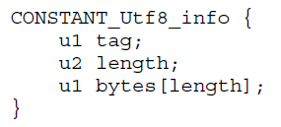
ca | fe | ba | be | 00 | 00 | 00 | 3a | 00 | 14 | 0a | 00 | 02 | 00 | 03 | 07
00 | 04 | 0c | 00 | 05 | 00 | 06 | 01 | 00 | 10 | 6a | 61 | 76 | 61 | 2f | 6c
61 | 6e | 67 | 2f | 4f | 62 | 6a | 65 | 63 | 74 | 01 | 00 | 06 | 3c | 69 | 6e
69 | 74 | 3e | 01 | 00 | 03 | 28 | 29 | 56 | 09 | 00 | 08 | 00 | 09 | 07 | 00
0a | 0c | 00 | 0b | 00 | 0c | 01 | 00 | 04 | 44 | 65 | 6d | 6f | 01 | 00 | 01
6e | 01 | 00 | 01 | 49 | 01 | 00 | 04 | 43 | 6f | 64 | 65 | 01 | 00 | 0f | 4c
69 | 6e | 65 | 4e | 75 | 6d | 62 | 65 | 72 | 54 | 61 | 62 | 6c | 65 | 01 | 00
03 | 61 | 64 | 64 | 01 | 00 | 05 | 28 | 49 | 49 | 29 | 49 | 01 | 00 | 05 | 6d
69 | 6e | 75 | 73 | 01 | 00 | 0a | 53 | 6f | 75 | 72 | 63 | 65 | 46 | 69 | 6c
65 | 01 | 00 | 09 | 44 | 65 | 6d | 6f | 2e | 6a | 61 | 76 | 61 | 00 | 21 | 00
08 | 00 | 02 | 00 | 00 | 00 | 01 | 00 | 02 | 00 | 0b | 00 | 0c | 00 | 00 | 00
03 | 00 | 01 | 00 | 05 | 00 | 06 | 00 | 01 | 00 | 0d | 00 | 00 | 00 | 26 | 00
02 | 00 | 01 | 00 | 00 | 00 | 0a | 2a | b7 | 00 | 01 | 2a | 08 | b5 | 00 | 07
b1 | 00 | 00 | 00 | 01 | 00 | 0e | 00 | 00 | 00 | 0a | 00 | 02 | 00 | 00 | 00
01 | 00 | 04 | 00 | 02 | 00 | 02 | 00 | 0f | 00 | 10 | 00 | 01 | 00 | 0d | 00
00 | 00 | 22 | 00 | 02 | 00 | 04 | 00 | 00 | 00 | 06 | 1b | 1c | 60 | 3e | 1d
ac | 00 | 00 | 00 | 01 | 00 | 0e | 00 | 00 | 00 | 0a | 00 | 02 | 00 | 00 | 00
05 | 00 | 04 | 00 | 06 | 00 | 04 | 00 | 11 | 00 | 10 | 00 | 01 | 00 | 0d | 00
00 | 00 | 22 | 00 | 02 | 00 | 04 | 00 | 00 | 00 | 06 | 1b | 1c | 64 | 3e | 1d
ac | 00 | 00 | 00 | 01 | 00 | 0e | 00 | 00 | 00 | 0a | 00 | 02 | 00 | 00 | 00
0a | 00 | 04 | 00 | 0b | 00 | 01 | 00 | 12 | 00 | 00 | 00 | 02 | 00 | 13 | 0a
Constant Pool
#4 = Utf8 java/lang/Object
#5 = Utf8 <init>
#6 = Utf8 ()V
ASCII Table
Char | A | B | C | D | E | F | G | H | I | J | K | L | M | N | O | P | Q | R | S | T | U | V | W | X | Y | Z
Hex | 41 | 42 | 43 | 44 | 45 | 46 | 47 | 48 | 49 | 4A | 4B | 4C | 4D | 4E | 4F | 50 | 51 | 52 | 53 | 54 | 55 | 56 | 57 | 58 | 59 | 5A
Char | a | b | c | d | e | f | g | h | i | j | k | l | m | n | o | p | q | r | s | t | u | v | w | x | y | Z
Hex | 61 | 62 | 63 | 64 | 65 | 66 | 67 | 68 | 69 | 6A | 6B | 6C | 6D | 6E | 6F | 70 | 71 | 72 | 73 | 74 | 75 | 76 | 77 | 78 | 79 | 7A
Char | ( | ) | . | / | < | >
Hex | 28 | 29 | 2E | 2F | 3C | 3E

Slide 15
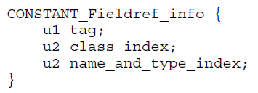
ca | fe | ba | be | 00 | 00 | 00 | 3a | 00 | 14 | 0a | 00 | 02 | 00 | 03 | 07
00 | 04 | 0c | 00 | 05 | 00 | 06 | 01 | 00 | 10 | 6a | 61 | 76 | 61 | 2f | 6c
61 | 6e | 67 | 2f | 4f | 62 | 6a | 65 | 63 | 74 | 01 | 00 | 06 | 3c | 69 | 6e
69 | 74 | 3e | 01 | 00 | 03 | 28 | 29 | 56 | 09 | 00 | 08 | 00 | 09 | 07 | 00
0a | 0c | 00 | 0b | 00 | 0c | 01 | 00 | 04 | 44 | 65 | 6d | 6f | 01 | 00 | 01
6e | 01 | 00 | 01 | 49 | 01 | 00 | 04 | 43 | 6f | 64 | 65 | 01 | 00 | 0f | 4c
69 | 6e | 65 | 4e | 75 | 6d | 62 | 65 | 72 | 54 | 61 | 62 | 6c | 65 | 01 | 00
03 | 61 | 64 | 64 | 01 | 00 | 05 | 28 | 49 | 49 | 29 | 49 | 01 | 00 | 05 | 6d
69 | 6e | 75 | 73 | 01 | 00 | 0a | 53 | 6f | 75 | 72 | 63 | 65 | 46 | 69 | 6c
65 | 01 | 00 | 09 | 44 | 65 | 6d | 6f | 2e | 6a | 61 | 76 | 61 | 00 | 21 | 00
08 | 00 | 02 | 00 | 00 | 00 | 01 | 00 | 02 | 00 | 0b | 00 | 0c | 00 | 00 | 00
03 | 00 | 01 | 00 | 05 | 00 | 06 | 00 | 01 | 00 | 0d | 00 | 00 | 00 | 26 | 00
02 | 00 | 01 | 00 | 00 | 00 | 0a | 2a | b7 | 00 | 01 | 2a | 08 | b5 | 00 | 07
b1 | 00 | 00 | 00 | 01 | 00 | 0e | 00 | 00 | 00 | 0a | 00 | 02 | 00 | 00 | 00
01 | 00 | 04 | 00 | 02 | 00 | 02 | 00 | 0f | 00 | 10 | 00 | 01 | 00 | 0d | 00
00 | 00 | 22 | 00 | 02 | 00 | 04 | 00 | 00 | 00 | 06 | 1b | 1c | 60 | 3e | 1d
ac | 00 | 00 | 00 | 01 | 00 | 0e | 00 | 00 | 00 | 0a | 00 | 02 | 00 | 00 | 00
05 | 00 | 04 | 00 | 06 | 00 | 04 | 00 | 11 | 00 | 10 | 00 | 01 | 00 | 0d | 00
00 | 00 | 22 | 00 | 02 | 00 | 04 | 00 | 00 | 00 | 06 | 1b | 1c | 64 | 3e | 1d
ac | 00 | 00 | 00 | 01 | 00 | 0e | 00 | 00 | 00 | 0a | 00 | 02 | 00 | 00 | 00
0a | 00 | 04 | 00 | 0b | 00 | 01 | 00 | 12 | 00 | 00 | 00 | 02 | 00 | 13 | 0a
Constant Pool
#7 = Fieldref #8.#9
#8 = Class #10
#9 = NameAndType #11:#12

Slide 16
ca | fe | ba | be | 00 | 00 | 00 | 3a | 00 | 14 | 0a | 00 | 02 | 00 | 03 | 07
00 | 04 | 0c | 00 | 05 | 00 | 06 | 01 | 00 | 10 | 6a | 61 | 76 | 61 | 2f | 6c
61 | 6e | 67 | 2f | 4f | 62 | 6a | 65 | 63 | 74 | 01 | 00 | 06 | 3c | 69 | 6e
69 | 74 | 3e | 01 | 00 | 03 | 28 | 29 | 56 | 09 | 00 | 08 | 00 | 09 | 07 | 00
0a | 0c | 00 | 0b | 00 | 0c | 01 | 00 | 04 | 44 | 65 | 6d | 6f | 01 | 00 | 01
6e | 01 | 00 | 01 | 49 | 01 | 00 | 04 | 43 | 6f | 64 | 65 | 01 | 00 | 0f | 4c
69 | 6e | 65 | 4e | 75 | 6d | 62 | 65 | 72 | 54 | 61 | 62 | 6c | 65 | 01 | 00
03 | 61 | 64 | 64 | 01 | 00 | 05 | 28 | 49 | 49 | 29 | 49 | 01 | 00 | 05 | 6d
69 | 6e | 75 | 73 | 01 | 00 | 0a | 53 | 6f | 75 | 72 | 63 | 65 | 46 | 69 | 6c
65 | 01 | 00 | 09 | 44 | 65 | 6d | 6f | 2e | 6a | 61 | 76 | 61 | 00 | 21 | 00
08 | 00 | 02 | 00 | 00 | 00 | 01 | 00 | 02 | 00 | 0b | 00 | 0c | 00 | 00 | 00
03 | 00 | 01 | 00 | 05 | 00 | 06 | 00 | 01 | 00 | 0d | 00 | 00 | 00 | 26 | 00
02 | 00 | 01 | 00 | 00 | 00 | 0a | 2a | b7 | 00 | 01 | 2a | 08 | b5 | 00 | 07
b1 | 00 | 00 | 00 | 01 | 00 | 0e | 00 | 00 | 00 | 0a | 00 | 02 | 00 | 00 | 00
01 | 00 | 04 | 00 | 02 | 00 | 02 | 00 | 0f | 00 | 10 | 00 | 01 | 00 | 0d | 00
00 | 00 | 22 | 00 | 02 | 00 | 04 | 00 | 00 | 00 | 06 | 1b | 1c | 60 | 3e | 1d
ac | 00 | 00 | 00 | 01 | 00 | 0e | 00 | 00 | 00 | 0a | 00 | 02 | 00 | 00 | 00
05 | 00 | 04 | 00 | 06 | 00 | 04 | 00 | 11 | 00 | 10 | 00 | 01 | 00 | 0d | 00
00 | 00 | 22 | 00 | 02 | 00 | 04 | 00 | 00 | 00 | 06 | 1b | 1c | 64 | 3e | 1d
ac | 00 | 00 | 00 | 01 | 00 | 0e | 00 | 00 | 00 | 0a | 00 | 02 | 00 | 00 | 00
0a | 00 | 04 | 00 | 0b | 00 | 01 | 00 | 12 | 00 | 00 | 00 | 02 | 00 | 13 | 0a
Constant Pool
#10 = Utf8 Demo
#11 = Utf8 n
#12 = Utf8 I
ASCII Table
Char | A | B | C | D | E | F | G | H | I | J | K | L | M | N | O | P | Q | R | S | T | U | V | W | X | Y | Z
Hex | 41 | 42 | 43 | 44 | 45 | 46 | 47 | 48 | 49 | 4A | 4B | 4C | 4D | 4E | 4F | 50 | 51 | 52 | 53 | 54 | 55 | 56 | 57 | 58 | 59 | 5A
Char | a | b | c | d | e | f | g | h | i | j | k | l | m | n | o | p | q | r | s | t | u | v | w | x | y | Z
Hex | 61 | 62 | 63 | 64 | 65 | 66 | 67 | 68 | 69 | 6A | 6B | 6C | 6D | 6E | 6F | 70 | 71 | 72 | 73 | 74 | 75 | 76 | 77 | 78 | 79 | 7A
Char | ( | ) | . | / | < | >
Hex | 28 | 29 | 2E | 2F | 3C | 3E

Slide 17
ca | fe | ba | be | 00 | 00 | 00 | 3a | 00 | 14 | 0a | 00 | 02 | 00 | 03 | 07
00 | 04 | 0c | 00 | 05 | 00 | 06 | 01 | 00 | 10 | 6a | 61 | 76 | 61 | 2f | 6c
61 | 6e | 67 | 2f | 4f | 62 | 6a | 65 | 63 | 74 | 01 | 00 | 06 | 3c | 69 | 6e
69 | 74 | 3e | 01 | 00 | 03 | 28 | 29 | 56 | 09 | 00 | 08 | 00 | 09 | 07 | 00
0a | 0c | 00 | 0b | 00 | 0c | 01 | 00 | 04 | 44 | 65 | 6d | 6f | 01 | 00 | 01
6e | 01 | 00 | 01 | 49 | 01 | 00 | 04 | 43 | 6f | 64 | 65 | 01 | 00 | 0f | 4c
69 | 6e | 65 | 4e | 75 | 6d | 62 | 65 | 72 | 54 | 61 | 62 | 6c | 65 | 01 | 00
03 | 61 | 64 | 64 | 01 | 00 | 05 | 28 | 49 | 49 | 29 | 49 | 01 | 00 | 05 | 6d
69 | 6e | 75 | 73 | 01 | 00 | 0a | 53 | 6f | 75 | 72 | 63 | 65 | 46 | 69 | 6c
65 | 01 | 00 | 09 | 44 | 65 | 6d | 6f | 2e | 6a | 61 | 76 | 61 | 00 | 21 | 00
08 | 00 | 02 | 00 | 00 | 00 | 01 | 00 | 02 | 00 | 0b | 00 | 0c | 00 | 00 | 00
03 | 00 | 01 | 00 | 05 | 00 | 06 | 00 | 01 | 00 | 0d | 00 | 00 | 00 | 26 | 00
02 | 00 | 01 | 00 | 00 | 00 | 0a | 2a | b7 | 00 | 01 | 2a | 08 | b5 | 00 | 07
b1 | 00 | 00 | 00 | 01 | 00 | 0e | 00 | 00 | 00 | 0a | 00 | 02 | 00 | 00 | 00
01 | 00 | 04 | 00 | 02 | 00 | 02 | 00 | 0f | 00 | 10 | 00 | 01 | 00 | 0d | 00
00 | 00 | 22 | 00 | 02 | 00 | 04 | 00 | 00 | 00 | 06 | 1b | 1c | 60 | 3e | 1d
ac | 00 | 00 | 00 | 01 | 00 | 0e | 00 | 00 | 00 | 0a | 00 | 02 | 00 | 00 | 00
05 | 00 | 04 | 00 | 06 | 00 | 04 | 00 | 11 | 00 | 10 | 00 | 01 | 00 | 0d | 00
00 | 00 | 22 | 00 | 02 | 00 | 04 | 00 | 00 | 00 | 06 | 1b | 1c | 64 | 3e | 1d
ac | 00 | 00 | 00 | 01 | 00 | 0e | 00 | 00 | 00 | 0a | 00 | 02 | 00 | 00 | 00
0a | 00 | 04 | 00 | 0b | 00 | 01 | 00 | 12 | 00 | 00 | 00 | 02 | 00 | 13 | 0a
Constant Pool
#13 = Utf8 Code
#14 = Utf8 LineNumberTable
#15 = Utf8 add
ASCII Table
Char | A | B | C | D | E | F | G | H | I | J | K | L | M | N | O | P | Q | R | S | T | U | V | W | X | Y | Z
Hex | 41 | 42 | 43 | 44 | 45 | 46 | 47 | 48 | 49 | 4A | 4B | 4C | 4D | 4E | 4F | 50 | 51 | 52 | 53 | 54 | 55 | 56 | 57 | 58 | 59 | 5A
Char | a | b | c | d | e | f | g | h | i | j | k | l | m | n | o | p | q | r | s | t | u | v | w | x | y | Z
Hex | 61 | 62 | 63 | 64 | 65 | 66 | 67 | 68 | 69 | 6A | 6B | 6C | 6D | 6E | 6F | 70 | 71 | 72 | 73 | 74 | 75 | 76 | 77 | 78 | 79 | 7A
Char | ( | ) | . | / | < | >
Hex | 28 | 29 | 2E | 2F | 3C | 3E

Slide 18
ca | fe | ba | be | 00 | 00 | 00 | 3a | 00 | 14 | 0a | 00 | 02 | 00 | 03 | 07
00 | 04 | 0c | 00 | 05 | 00 | 06 | 01 | 00 | 10 | 6a | 61 | 76 | 61 | 2f | 6c
61 | 6e | 67 | 2f | 4f | 62 | 6a | 65 | 63 | 74 | 01 | 00 | 06 | 3c | 69 | 6e
69 | 74 | 3e | 01 | 00 | 03 | 28 | 29 | 56 | 09 | 00 | 08 | 00 | 09 | 07 | 00
0a | 0c | 00 | 0b | 00 | 0c | 01 | 00 | 04 | 44 | 65 | 6d | 6f | 01 | 00 | 01
6e | 01 | 00 | 01 | 49 | 01 | 00 | 04 | 43 | 6f | 64 | 65 | 01 | 00 | 0f | 4c
69 | 6e | 65 | 4e | 75 | 6d | 62 | 65 | 72 | 54 | 61 | 62 | 6c | 65 | 01 | 00
03 | 61 | 64 | 64 | 01 | 00 | 05 | 28 | 49 | 49 | 29 | 49 | 01 | 00 | 05 | 6d
69 | 6e | 75 | 73 | 01 | 00 | 0a | 53 | 6f | 75 | 72 | 63 | 65 | 46 | 69 | 6c
65 | 01 | 00 | 09 | 44 | 65 | 6d | 6f | 2e | 6a | 61 | 76 | 61 | 00 | 21 | 00
08 | 00 | 02 | 00 | 00 | 00 | 01 | 00 | 02 | 00 | 0b | 00 | 0c | 00 | 00 | 00
03 | 00 | 01 | 00 | 05 | 00 | 06 | 00 | 01 | 00 | 0d | 00 | 00 | 00 | 26 | 00
02 | 00 | 01 | 00 | 00 | 00 | 0a | 2a | b7 | 00 | 01 | 2a | 08 | b5 | 00 | 07
b1 | 00 | 00 | 00 | 01 | 00 | 0e | 00 | 00 | 00 | 0a | 00 | 02 | 00 | 00 | 00
01 | 00 | 04 | 00 | 02 | 00 | 02 | 00 | 0f | 00 | 10 | 00 | 01 | 00 | 0d | 00
00 | 00 | 22 | 00 | 02 | 00 | 04 | 00 | 00 | 00 | 06 | 1b | 1c | 60 | 3e | 1d
ac | 00 | 00 | 00 | 01 | 00 | 0e | 00 | 00 | 00 | 0a | 00 | 02 | 00 | 00 | 00
05 | 00 | 04 | 00 | 06 | 00 | 04 | 00 | 11 | 00 | 10 | 00 | 01 | 00 | 0d | 00
00 | 00 | 22 | 00 | 02 | 00 | 04 | 00 | 00 | 00 | 06 | 1b | 1c | 64 | 3e | 1d
ac | 00 | 00 | 00 | 01 | 00 | 0e | 00 | 00 | 00 | 0a | 00 | 02 | 00 | 00 | 00
0a | 00 | 04 | 00 | 0b | 00 | 01 | 00 | 12 | 00 | 00 | 00 | 02 | 00 | 13 | 0a
Constant Pool
#16 = Utf8 (II)I
#17 = Utf8 minus
#18 = Utf8 SourceFile
#19 = Utf8 Demo.java
ASCII Table
Char | A | B | C | D | E | F | G | H | I | J | K | L | M | N | O | P | Q | R | S | T | U | V | W | X | Y | Z
Hex | 41 | 42 | 43 | 44 | 45 | 46 | 47 | 48 | 49 | 4A | 4B | 4C | 4D | 4E | 4F | 50 | 51 | 52 | 53 | 54 | 55 | 56 | 57 | 58 | 59 | 5A
Char | a | b | c | d | e | f | g | h | i | j | k | l | m | n | o | p | q | r | s | t | u | v | w | x | y | Z
Hex | 61 | 62 | 63 | 64 | 65 | 66 | 67 | 68 | 69 | 6A | 6B | 6C | 6D | 6E | 6F | 70 | 71 | 72 | 73 | 74 | 75 | 76 | 77 | 78 | 79 | 7A
Char | ( | ) | . | / | < | >
Hex | 28 | 29 | 2E | 2F | 3C | 3E

Slide 19
ca | fe | ba | be | 00 | 00 | 00 | 3a | 00 | 14 | 0a | 00 | 02 | 00 | 03 | 07
00 | 04 | 0c | 00 | 05 | 00 | 06 | 01 | 00 | 10 | 6a | 61 | 76 | 61 | 2f | 6c
61 | 6e | 67 | 2f | 4f | 62 | 6a | 65 | 63 | 74 | 01 | 00 | 06 | 3c | 69 | 6e
69 | 74 | 3e | 01 | 00 | 03 | 28 | 29 | 56 | 09 | 00 | 08 | 00 | 09 | 07 | 00
0a | 0c | 00 | 0b | 00 | 0c | 01 | 00 | 04 | 44 | 65 | 6d | 6f | 01 | 00 | 01
6e | 01 | 00 | 01 | 49 | 01 | 00 | 04 | 43 | 6f | 64 | 65 | 01 | 00 | 0f | 4c
69 | 6e | 65 | 4e | 75 | 6d | 62 | 65 | 72 | 54 | 61 | 62 | 6c | 65 | 01 | 00
03 | 61 | 64 | 64 | 01 | 00 | 05 | 28 | 49 | 49 | 29 | 49 | 01 | 00 | 05 | 6d
69 | 6e | 75 | 73 | 01 | 00 | 0a | 53 | 6f | 75 | 72 | 63 | 65 | 46 | 69 | 6c
65 | 01 | 00 | 09 | 44 | 65 | 6d | 6f | 2e | 6a | 61 | 76 | 61 | 00 | 21 | 00
08 | 00 | 02 | 00 | 00 | 00 | 01 | 00 | 02 | 00 | 0b | 00 | 0c | 00 | 00 | 00
03 | 00 | 01 | 00 | 05 | 00 | 06 | 00 | 01 | 00 | 0d | 00 | 00 | 00 | 26 | 00
02 | 00 | 01 | 00 | 00 | 00 | 0a | 2a | b7 | 00 | 01 | 2a | 08 | b5 | 00 | 07
b1 | 00 | 00 | 00 | 01 | 00 | 0e | 00 | 00 | 00 | 0a | 00 | 02 | 00 | 00 | 00
01 | 00 | 04 | 00 | 02 | 00 | 02 | 00 | 0f | 00 | 10 | 00 | 01 | 00 | 0d | 00
00 | 00 | 22 | 00 | 02 | 00 | 04 | 00 | 00 | 00 | 06 | 1b | 1c | 60 | 3e | 1d
ac | 00 | 00 | 00 | 01 | 00 | 0e | 00 | 00 | 00 | 0a | 00 | 02 | 00 | 00 | 00
05 | 00 | 04 | 00 | 06 | 00 | 04 | 00 | 11 | 00 | 10 | 00 | 01 | 00 | 0d | 00
00 | 00 | 22 | 00 | 02 | 00 | 04 | 00 | 00 | 00 | 06 | 1b | 1c | 64 | 3e | 1d
ac | 00 | 00 | 00 | 01 | 00 | 0e | 00 | 00 | 00 | 0a | 00 | 02 | 00 | 00 | 00
0a | 00 | 04 | 00 | 0b | 00 | 01 | 00 | 12 | 00 | 00 | 00 | 02 | 00 | 13 | 0a
Constant Pool
#1 = Methodref | #2.#3 | // java/lang/Object.“<init>”:()V
#2 = Class | #4 | // java/lang/Object
#3 = NameAndType | #5:#6 | // “<init>”:()V
#4 = Utf8 | java/lang/Object
#5 = Utf8 | <init>
#6 = Utf8 | ()V
#7 = Fieldref | #8.#9 | // Demo.n:I
#8 = Class | #10 | // Demo
#9 = NameAndType | #11:#12 | // n:I
#10 = Utf8 | Demo
#11 = Utf8 | n
#12 = Utf8 | I
#13 = Utf8 | Code
#14 = Utf8 | LineNumberTable
#15 = Utf8 | add
#16 = Utf8 | (II)I
#17 = Utf8 | minus
#18 = Utf8 | SourceFile
#19 = Utf8 | Demo.java

Slide 20
Access
Flags

Slide 21
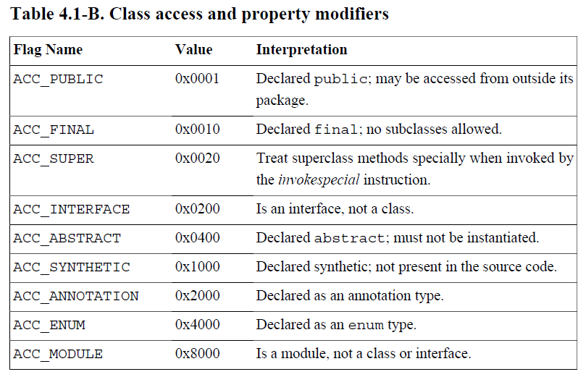
ca | fe | ba | be | 00 | 00 | 00 | 3a | 00 | 14 | 0a | 00 | 02 | 00 | 03 | 07
00 | 04 | 0c | 00 | 05 | 00 | 06 | 01 | 00 | 10 | 6a | 61 | 76 | 61 | 2f | 6c
61 | 6e | 67 | 2f | 4f | 62 | 6a | 65 | 63 | 74 | 01 | 00 | 06 | 3c | 69 | 6e
69 | 74 | 3e | 01 | 00 | 03 | 28 | 29 | 56 | 09 | 00 | 08 | 00 | 09 | 07 | 00
0a | 0c | 00 | 0b | 00 | 0c | 01 | 00 | 04 | 44 | 65 | 6d | 6f | 01 | 00 | 01
6e | 01 | 00 | 01 | 49 | 01 | 00 | 04 | 43 | 6f | 64 | 65 | 01 | 00 | 0f | 4c
69 | 6e | 65 | 4e | 75 | 6d | 62 | 65 | 72 | 54 | 61 | 62 | 6c | 65 | 01 | 00
03 | 61 | 64 | 64 | 01 | 00 | 05 | 28 | 49 | 49 | 29 | 49 | 01 | 00 | 05 | 6d
69 | 6e | 75 | 73 | 01 | 00 | 0a | 53 | 6f | 75 | 72 | 63 | 65 | 46 | 69 | 6c
65 | 01 | 00 | 09 | 44 | 65 | 6d | 6f | 2e | 6a | 61 | 76 | 61 | 00 | 21 | 00
08 | 00 | 02 | 00 | 00 | 00 | 01 | 00 | 02 | 00 | 0b | 00 | 0c | 00 | 00 | 00
03 | 00 | 01 | 00 | 05 | 00 | 06 | 00 | 01 | 00 | 0d | 00 | 00 | 00 | 26 | 00
02 | 00 | 01 | 00 | 00 | 00 | 0a | 2a | b7 | 00 | 01 | 2a | 08 | b5 | 00 | 07
b1 | 00 | 00 | 00 | 01 | 00 | 0e | 00 | 00 | 00 | 0a | 00 | 02 | 00 | 00 | 00
01 | 00 | 04 | 00 | 02 | 00 | 02 | 00 | 0f | 00 | 10 | 00 | 01 | 00 | 0d | 00
00 | 00 | 22 | 00 | 02 | 00 | 04 | 00 | 00 | 00 | 06 | 1b | 1c | 60 | 3e | 1d
ac | 00 | 00 | 00 | 01 | 00 | 0e | 00 | 00 | 00 | 0a | 00 | 02 | 00 | 00 | 00
05 | 00 | 04 | 00 | 06 | 00 | 04 | 00 | 11 | 00 | 10 | 00 | 01 | 00 | 0d | 00
00 | 00 | 22 | 00 | 02 | 00 | 04 | 00 | 00 | 00 | 06 | 1b | 1c | 64 | 3e | 1d
ac | 00 | 00 | 00 | 01 | 00 | 0e | 00 | 00 | 00 | 0a | 00 | 02 | 00 | 00 | 00
0a | 00 | 04 | 00 | 0b | 00 | 01 | 00 | 12 | 00 | 00 | 00 | 02 | 00 | 13 | 0a
Access Flags
Access Flag: 0x0021
0x0021 = 0x0020 + 0x0001
ACC_SUPER ACC_PUBLIC

Slide 22
This
Class

Slide 23
ca | fe | ba | be | 00 | 00 | 00 | 3a | 00 | 14 | 0a | 00 | 02 | 00 | 03 | 07
00 | 04 | 0c | 00 | 05 | 00 | 06 | 01 | 00 | 10 | 6a | 61 | 76 | 61 | 2f | 6c
61 | 6e | 67 | 2f | 4f | 62 | 6a | 65 | 63 | 74 | 01 | 00 | 06 | 3c | 69 | 6e
69 | 74 | 3e | 01 | 00 | 03 | 28 | 29 | 56 | 09 | 00 | 08 | 00 | 09 | 07 | 00
0a | 0c | 00 | 0b | 00 | 0c | 01 | 00 | 04 | 44 | 65 | 6d | 6f | 01 | 00 | 01
6e | 01 | 00 | 01 | 49 | 01 | 00 | 04 | 43 | 6f | 64 | 65 | 01 | 00 | 0f | 4c
69 | 6e | 65 | 4e | 75 | 6d | 62 | 65 | 72 | 54 | 61 | 62 | 6c | 65 | 01 | 00
03 | 61 | 64 | 64 | 01 | 00 | 05 | 28 | 49 | 49 | 29 | 49 | 01 | 00 | 05 | 6d
69 | 6e | 75 | 73 | 01 | 00 | 0a | 53 | 6f | 75 | 72 | 63 | 65 | 46 | 69 | 6c
65 | 01 | 00 | 09 | 44 | 65 | 6d | 6f | 2e | 6a | 61 | 76 | 61 | 00 | 21 | 00
08 | 00 | 02 | 00 | 00 | 00 | 01 | 00 | 02 | 00 | 0b | 00 | 0c | 00 | 00 | 00
03 | 00 | 01 | 00 | 05 | 00 | 06 | 00 | 01 | 00 | 0d | 00 | 00 | 00 | 26 | 00
02 | 00 | 01 | 00 | 00 | 00 | 0a | 2a | b7 | 00 | 01 | 2a | 08 | b5 | 00 | 07
b1 | 00 | 00 | 00 | 01 | 00 | 0e | 00 | 00 | 00 | 0a | 00 | 02 | 00 | 00 | 00
01 | 00 | 04 | 00 | 02 | 00 | 02 | 00 | 0f | 00 | 10 | 00 | 01 | 00 | 0d | 00
00 | 00 | 22 | 00 | 02 | 00 | 04 | 00 | 00 | 00 | 06 | 1b | 1c | 60 | 3e | 1d
ac | 00 | 00 | 00 | 01 | 00 | 0e | 00 | 00 | 00 | 0a | 00 | 02 | 00 | 00 | 00
05 | 00 | 04 | 00 | 06 | 00 | 04 | 00 | 11 | 00 | 10 | 00 | 01 | 00 | 0d | 00
00 | 00 | 22 | 00 | 02 | 00 | 04 | 00 | 00 | 00 | 06 | 1b | 1c | 64 | 3e | 1d
ac | 00 | 00 | 00 | 01 | 00 | 0e | 00 | 00 | 00 | 0a | 00 | 02 | 00 | 00 | 00
0a | 00 | 04 | 00 | 0b | 00 | 01 | 00 | 12 | 00 | 00 | 00 | 02 | 00 | 13 | 0a
This Class
This Class: 0x0008 = 8
#8 = Class #10
#10 = Utf8 Demo

Slide 24
Super
Class

Slide 25
ca | fe | ba | be | 00 | 00 | 00 | 3a | 00 | 14 | 0a | 00 | 02 | 00 | 03 | 07
00 | 04 | 0c | 00 | 05 | 00 | 06 | 01 | 00 | 10 | 6a | 61 | 76 | 61 | 2f | 6c
61 | 6e | 67 | 2f | 4f | 62 | 6a | 65 | 63 | 74 | 01 | 00 | 06 | 3c | 69 | 6e
69 | 74 | 3e | 01 | 00 | 03 | 28 | 29 | 56 | 09 | 00 | 08 | 00 | 09 | 07 | 00
0a | 0c | 00 | 0b | 00 | 0c | 01 | 00 | 04 | 44 | 65 | 6d | 6f | 01 | 00 | 01
6e | 01 | 00 | 01 | 49 | 01 | 00 | 04 | 43 | 6f | 64 | 65 | 01 | 00 | 0f | 4c
69 | 6e | 65 | 4e | 75 | 6d | 62 | 65 | 72 | 54 | 61 | 62 | 6c | 65 | 01 | 00
03 | 61 | 64 | 64 | 01 | 00 | 05 | 28 | 49 | 49 | 29 | 49 | 01 | 00 | 05 | 6d
69 | 6e | 75 | 73 | 01 | 00 | 0a | 53 | 6f | 75 | 72 | 63 | 65 | 46 | 69 | 6c
65 | 01 | 00 | 09 | 44 | 65 | 6d | 6f | 2e | 6a | 61 | 76 | 61 | 00 | 21 | 00
08 | 00 | 02 | 00 | 00 | 00 | 01 | 00 | 02 | 00 | 0b | 00 | 0c | 00 | 00 | 00
03 | 00 | 01 | 00 | 05 | 00 | 06 | 00 | 01 | 00 | 0d | 00 | 00 | 00 | 26 | 00
02 | 00 | 01 | 00 | 00 | 00 | 0a | 2a | b7 | 00 | 01 | 2a | 08 | b5 | 00 | 07
b1 | 00 | 00 | 00 | 01 | 00 | 0e | 00 | 00 | 00 | 0a | 00 | 02 | 00 | 00 | 00
01 | 00 | 04 | 00 | 02 | 00 | 02 | 00 | 0f | 00 | 10 | 00 | 01 | 00 | 0d | 00
00 | 00 | 22 | 00 | 02 | 00 | 04 | 00 | 00 | 00 | 06 | 1b | 1c | 60 | 3e | 1d
ac | 00 | 00 | 00 | 01 | 00 | 0e | 00 | 00 | 00 | 0a | 00 | 02 | 00 | 00 | 00
05 | 00 | 04 | 00 | 06 | 00 | 04 | 00 | 11 | 00 | 10 | 00 | 01 | 00 | 0d | 00
00 | 00 | 22 | 00 | 02 | 00 | 04 | 00 | 00 | 00 | 06 | 1b | 1c | 64 | 3e | 1d
ac | 00 | 00 | 00 | 01 | 00 | 0e | 00 | 00 | 00 | 0a | 00 | 02 | 00 | 00 | 00
0a | 00 | 04 | 00 | 0b | 00 | 01 | 00 | 12 | 00 | 00 | 00 | 02 | 00 | 13 | 0a
Super Class
Super Class: 0x0002 = 2
#2 = Class #4
#4 = Utf8 java/lang/Object

Slide 26
Interfaces

Slide 27
ca | fe | ba | be | 00 | 00 | 00 | 3a | 00 | 14 | 0a | 00 | 02 | 00 | 03 | 07
00 | 04 | 0c | 00 | 05 | 00 | 06 | 01 | 00 | 10 | 6a | 61 | 76 | 61 | 2f | 6c
61 | 6e | 67 | 2f | 4f | 62 | 6a | 65 | 63 | 74 | 01 | 00 | 06 | 3c | 69 | 6e
69 | 74 | 3e | 01 | 00 | 03 | 28 | 29 | 56 | 09 | 00 | 08 | 00 | 09 | 07 | 00
0a | 0c | 00 | 0b | 00 | 0c | 01 | 00 | 04 | 44 | 65 | 6d | 6f | 01 | 00 | 01
6e | 01 | 00 | 01 | 49 | 01 | 00 | 04 | 43 | 6f | 64 | 65 | 01 | 00 | 0f | 4c
69 | 6e | 65 | 4e | 75 | 6d | 62 | 65 | 72 | 54 | 61 | 62 | 6c | 65 | 01 | 00
03 | 61 | 64 | 64 | 01 | 00 | 05 | 28 | 49 | 49 | 29 | 49 | 01 | 00 | 05 | 6d
69 | 6e | 75 | 73 | 01 | 00 | 0a | 53 | 6f | 75 | 72 | 63 | 65 | 46 | 69 | 6c
65 | 01 | 00 | 09 | 44 | 65 | 6d | 6f | 2e | 6a | 61 | 76 | 61 | 00 | 21 | 00
08 | 00 | 02 | 00 | 00 | 00 | 01 | 00 | 02 | 00 | 0b | 00 | 0c | 00 | 00 | 00
03 | 00 | 01 | 00 | 05 | 00 | 06 | 00 | 01 | 00 | 0d | 00 | 00 | 00 | 26 | 00
02 | 00 | 01 | 00 | 00 | 00 | 0a | 2a | b7 | 00 | 01 | 2a | 08 | b5 | 00 | 07
b1 | 00 | 00 | 00 | 01 | 00 | 0e | 00 | 00 | 00 | 0a | 00 | 02 | 00 | 00 | 00
01 | 00 | 04 | 00 | 02 | 00 | 02 | 00 | 0f | 00 | 10 | 00 | 01 | 00 | 0d | 00
00 | 00 | 22 | 00 | 02 | 00 | 04 | 00 | 00 | 00 | 06 | 1b | 1c | 60 | 3e | 1d
ac | 00 | 00 | 00 | 01 | 00 | 0e | 00 | 00 | 00 | 0a | 00 | 02 | 00 | 00 | 00
05 | 00 | 04 | 00 | 06 | 00 | 04 | 00 | 11 | 00 | 10 | 00 | 01 | 00 | 0d | 00
00 | 00 | 22 | 00 | 02 | 00 | 04 | 00 | 00 | 00 | 06 | 1b | 1c | 64 | 3e | 1d
ac | 00 | 00 | 00 | 01 | 00 | 0e | 00 | 00 | 00 | 0a | 00 | 02 | 00 | 00 | 00
0a | 00 | 04 | 00 | 0b | 00 | 01 | 00 | 12 | 00 | 00 | 00 | 02 | 00 | 13 | 0a
Interfaces
Interfaces Count: 0x0000 = 0

Slide 28
Fields

Slide 29
ca | fe | ba | be | 00 | 00 | 00 | 3a | 00 | 14 | 0a | 00 | 02 | 00 | 03 | 07
00 | 04 | 0c | 00 | 05 | 00 | 06 | 01 | 00 | 10 | 6a | 61 | 76 | 61 | 2f | 6c
61 | 6e | 67 | 2f | 4f | 62 | 6a | 65 | 63 | 74 | 01 | 00 | 06 | 3c | 69 | 6e
69 | 74 | 3e | 01 | 00 | 03 | 28 | 29 | 56 | 09 | 00 | 08 | 00 | 09 | 07 | 00
0a | 0c | 00 | 0b | 00 | 0c | 01 | 00 | 04 | 44 | 65 | 6d | 6f | 01 | 00 | 01
6e | 01 | 00 | 01 | 49 | 01 | 00 | 04 | 43 | 6f | 64 | 65 | 01 | 00 | 0f | 4c
69 | 6e | 65 | 4e | 75 | 6d | 62 | 65 | 72 | 54 | 61 | 62 | 6c | 65 | 01 | 00
03 | 61 | 64 | 64 | 01 | 00 | 05 | 28 | 49 | 49 | 29 | 49 | 01 | 00 | 05 | 6d
69 | 6e | 75 | 73 | 01 | 00 | 0a | 53 | 6f | 75 | 72 | 63 | 65 | 46 | 69 | 6c
65 | 01 | 00 | 09 | 44 | 65 | 6d | 6f | 2e | 6a | 61 | 76 | 61 | 00 | 21 | 00
08 | 00 | 02 | 00 | 00 | 00 | 01 | 00 | 02 | 00 | 0b | 00 | 0c | 00 | 00 | 00
03 | 00 | 01 | 00 | 05 | 00 | 06 | 00 | 01 | 00 | 0d | 00 | 00 | 00 | 26 | 00
02 | 00 | 01 | 00 | 00 | 00 | 0a | 2a | b7 | 00 | 01 | 2a | 08 | b5 | 00 | 07
b1 | 00 | 00 | 00 | 01 | 00 | 0e | 00 | 00 | 00 | 0a | 00 | 02 | 00 | 00 | 00
01 | 00 | 04 | 00 | 02 | 00 | 02 | 00 | 0f | 00 | 10 | 00 | 01 | 00 | 0d | 00
00 | 00 | 22 | 00 | 02 | 00 | 04 | 00 | 00 | 00 | 06 | 1b | 1c | 60 | 3e | 1d
ac | 00 | 00 | 00 | 01 | 00 | 0e | 00 | 00 | 00 | 0a | 00 | 02 | 00 | 00 | 00
05 | 00 | 04 | 00 | 06 | 00 | 04 | 00 | 11 | 00 | 10 | 00 | 01 | 00 | 0d | 00
00 | 00 | 22 | 00 | 02 | 00 | 04 | 00 | 00 | 00 | 06 | 1b | 1c | 64 | 3e | 1d
ac | 00 | 00 | 00 | 01 | 00 | 0e | 00 | 00 | 00 | 0a | 00 | 02 | 00 | 00 | 00
0a | 00 | 04 | 00 | 0b | 00 | 01 | 00 | 12 | 00 | 00 | 00 | 02 | 00 | 13 | 0a
Fields
Fields Count: 0x0001 = 1

Slide 30
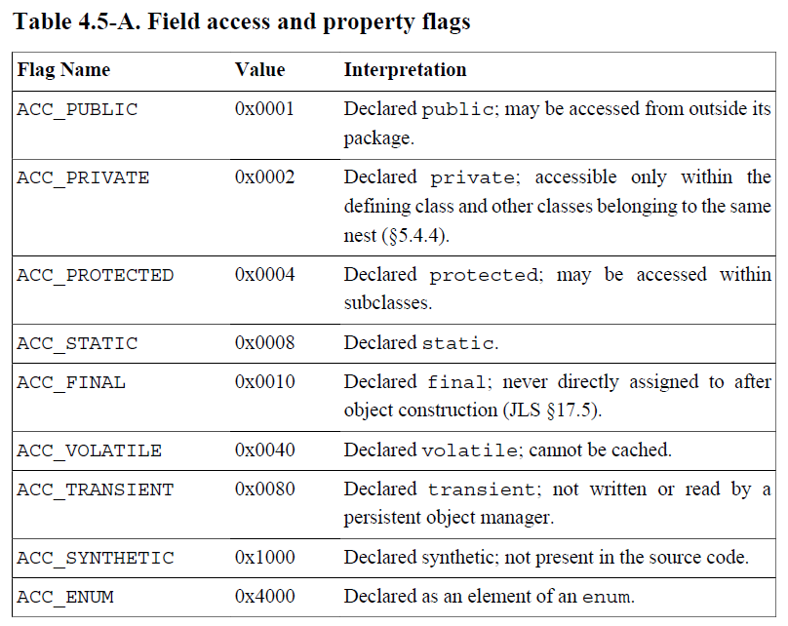
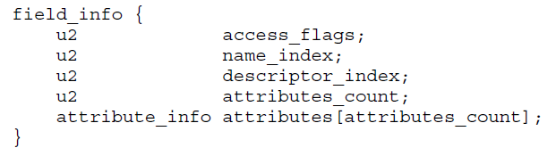
ca | fe | ba | be | 00 | 00 | 00 | 3a | 00 | 14 | 0a | 00 | 02 | 00 | 03 | 07
00 | 04 | 0c | 00 | 05 | 00 | 06 | 01 | 00 | 10 | 6a | 61 | 76 | 61 | 2f | 6c
61 | 6e | 67 | 2f | 4f | 62 | 6a | 65 | 63 | 74 | 01 | 00 | 06 | 3c | 69 | 6e
69 | 74 | 3e | 01 | 00 | 03 | 28 | 29 | 56 | 09 | 00 | 08 | 00 | 09 | 07 | 00
0a | 0c | 00 | 0b | 00 | 0c | 01 | 00 | 04 | 44 | 65 | 6d | 6f | 01 | 00 | 01
6e | 01 | 00 | 01 | 49 | 01 | 00 | 04 | 43 | 6f | 64 | 65 | 01 | 00 | 0f | 4c
69 | 6e | 65 | 4e | 75 | 6d | 62 | 65 | 72 | 54 | 61 | 62 | 6c | 65 | 01 | 00
03 | 61 | 64 | 64 | 01 | 00 | 05 | 28 | 49 | 49 | 29 | 49 | 01 | 00 | 05 | 6d
69 | 6e | 75 | 73 | 01 | 00 | 0a | 53 | 6f | 75 | 72 | 63 | 65 | 46 | 69 | 6c
65 | 01 | 00 | 09 | 44 | 65 | 6d | 6f | 2e | 6a | 61 | 76 | 61 | 00 | 21 | 00
08 | 00 | 02 | 00 | 00 | 00 | 01 | 00 | 02 | 00 | 0b | 00 | 0c | 00 | 00 | 00
03 | 00 | 01 | 00 | 05 | 00 | 06 | 00 | 01 | 00 | 0d | 00 | 00 | 00 | 26 | 00
02 | 00 | 01 | 00 | 00 | 00 | 0a | 2a | b7 | 00 | 01 | 2a | 08 | b5 | 00 | 07
b1 | 00 | 00 | 00 | 01 | 00 | 0e | 00 | 00 | 00 | 0a | 00 | 02 | 00 | 00 | 00
01 | 00 | 04 | 00 | 02 | 00 | 02 | 00 | 0f | 00 | 10 | 00 | 01 | 00 | 0d | 00
00 | 00 | 22 | 00 | 02 | 00 | 04 | 00 | 00 | 00 | 06 | 1b | 1c | 60 | 3e | 1d
ac | 00 | 00 | 00 | 01 | 00 | 0e | 00 | 00 | 00 | 0a | 00 | 02 | 00 | 00 | 00
05 | 00 | 04 | 00 | 06 | 00 | 04 | 00 | 11 | 00 | 10 | 00 | 01 | 00 | 0d | 00
00 | 00 | 22 | 00 | 02 | 00 | 04 | 00 | 00 | 00 | 06 | 1b | 1c | 64 | 3e | 1d
ac | 00 | 00 | 00 | 01 | 00 | 0e | 00 | 00 | 00 | 0a | 00 | 02 | 00 | 00 | 00
0a | 00 | 04 | 00 | 0b | 00 | 01 | 00 | 12 | 00 | 00 | 00 | 02 | 00 | 13 | 0a
Fields
Access Flags: 0x0002 ACC_PRIVATE
Name Index: 0x000b = 11
#11 = Utf8 n
Descriptor Index: 0x000c = 12
#12 = Utf8 I
Attributes Count: 0x0000 = 0

Slide 31
Methods

Slide 32
ca | fe | ba | be | 00 | 00 | 00 | 3a | 00 | 14 | 0a | 00 | 02 | 00 | 03 | 07
00 | 04 | 0c | 00 | 05 | 00 | 06 | 01 | 00 | 10 | 6a | 61 | 76 | 61 | 2f | 6c
61 | 6e | 67 | 2f | 4f | 62 | 6a | 65 | 63 | 74 | 01 | 00 | 06 | 3c | 69 | 6e
69 | 74 | 3e | 01 | 00 | 03 | 28 | 29 | 56 | 09 | 00 | 08 | 00 | 09 | 07 | 00
0a | 0c | 00 | 0b | 00 | 0c | 01 | 00 | 04 | 44 | 65 | 6d | 6f | 01 | 00 | 01
6e | 01 | 00 | 01 | 49 | 01 | 00 | 04 | 43 | 6f | 64 | 65 | 01 | 00 | 0f | 4c
69 | 6e | 65 | 4e | 75 | 6d | 62 | 65 | 72 | 54 | 61 | 62 | 6c | 65 | 01 | 00
03 | 61 | 64 | 64 | 01 | 00 | 05 | 28 | 49 | 49 | 29 | 49 | 01 | 00 | 05 | 6d
69 | 6e | 75 | 73 | 01 | 00 | 0a | 53 | 6f | 75 | 72 | 63 | 65 | 46 | 69 | 6c
65 | 01 | 00 | 09 | 44 | 65 | 6d | 6f | 2e | 6a | 61 | 76 | 61 | 00 | 21 | 00
08 | 00 | 02 | 00 | 00 | 00 | 01 | 00 | 02 | 00 | 0b | 00 | 0c | 00 | 00 | 00
03 | 00 | 01 | 00 | 05 | 00 | 06 | 00 | 01 | 00 | 0d | 00 | 00 | 00 | 26 | 00
02 | 00 | 01 | 00 | 00 | 00 | 0a | 2a | b7 | 00 | 01 | 2a | 08 | b5 | 00 | 07
b1 | 00 | 00 | 00 | 01 | 00 | 0e | 00 | 00 | 00 | 0a | 00 | 02 | 00 | 00 | 00
01 | 00 | 04 | 00 | 02 | 00 | 02 | 00 | 0f | 00 | 10 | 00 | 01 | 00 | 0d | 00
00 | 00 | 22 | 00 | 02 | 00 | 04 | 00 | 00 | 00 | 06 | 1b | 1c | 60 | 3e | 1d
ac | 00 | 00 | 00 | 01 | 00 | 0e | 00 | 00 | 00 | 0a | 00 | 02 | 00 | 00 | 00
05 | 00 | 04 | 00 | 06 | 00 | 04 | 00 | 11 | 00 | 10 | 00 | 01 | 00 | 0d | 00
00 | 00 | 22 | 00 | 02 | 00 | 04 | 00 | 00 | 00 | 06 | 1b | 1c | 64 | 3e | 1d
ac | 00 | 00 | 00 | 01 | 00 | 0e | 00 | 00 | 00 | 0a | 00 | 02 | 00 | 00 | 00
0a | 00 | 04 | 00 | 0b | 00 | 01 | 00 | 12 | 00 | 00 | 00 | 02 | 00 | 13 | 0a
Methods
Methods Count: 0x0003 = 3

Slide 33
Methods_1

Slide 34
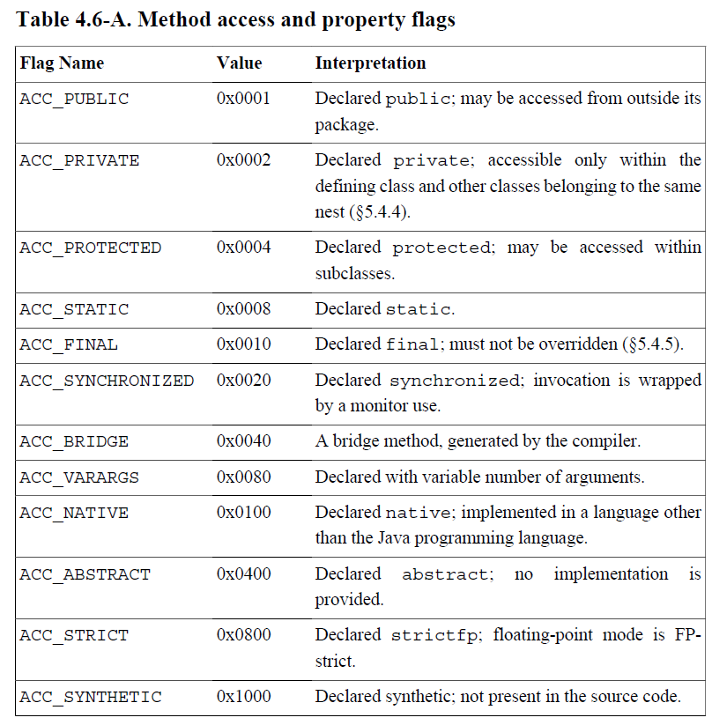
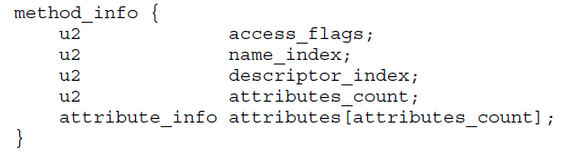
ca | fe | ba | be | 00 | 00 | 00 | 3a | 00 | 14 | 0a | 00 | 02 | 00 | 03 | 07
00 | 04 | 0c | 00 | 05 | 00 | 06 | 01 | 00 | 10 | 6a | 61 | 76 | 61 | 2f | 6c
61 | 6e | 67 | 2f | 4f | 62 | 6a | 65 | 63 | 74 | 01 | 00 | 06 | 3c | 69 | 6e
69 | 74 | 3e | 01 | 00 | 03 | 28 | 29 | 56 | 09 | 00 | 08 | 00 | 09 | 07 | 00
0a | 0c | 00 | 0b | 00 | 0c | 01 | 00 | 04 | 44 | 65 | 6d | 6f | 01 | 00 | 01
6e | 01 | 00 | 01 | 49 | 01 | 00 | 04 | 43 | 6f | 64 | 65 | 01 | 00 | 0f | 4c
69 | 6e | 65 | 4e | 75 | 6d | 62 | 65 | 72 | 54 | 61 | 62 | 6c | 65 | 01 | 00
03 | 61 | 64 | 64 | 01 | 00 | 05 | 28 | 49 | 49 | 29 | 49 | 01 | 00 | 05 | 6d
69 | 6e | 75 | 73 | 01 | 00 | 0a | 53 | 6f | 75 | 72 | 63 | 65 | 46 | 69 | 6c
65 | 01 | 00 | 09 | 44 | 65 | 6d | 6f | 2e | 6a | 61 | 76 | 61 | 00 | 21 | 00
08 | 00 | 02 | 00 | 00 | 00 | 01 | 00 | 02 | 00 | 0b | 00 | 0c | 00 | 00 | 00
03 | 00 | 01 | 00 | 05 | 00 | 06 | 00 | 01 | 00 | 0d | 00 | 00 | 00 | 26 | 00
02 | 00 | 01 | 00 | 00 | 00 | 0a | 2a | b7 | 00 | 01 | 2a | 08 | b5 | 00 | 07
b1 | 00 | 00 | 00 | 01 | 00 | 0e | 00 | 00 | 00 | 0a | 00 | 02 | 00 | 00 | 00
01 | 00 | 04 | 00 | 02 | 00 | 02 | 00 | 0f | 00 | 10 | 00 | 01 | 00 | 0d | 00
00 | 00 | 22 | 00 | 02 | 00 | 04 | 00 | 00 | 00 | 06 | 1b | 1c | 60 | 3e | 1d
ac | 00 | 00 | 00 | 01 | 00 | 0e | 00 | 00 | 00 | 0a | 00 | 02 | 00 | 00 | 00
05 | 00 | 04 | 00 | 06 | 00 | 04 | 00 | 11 | 00 | 10 | 00 | 01 | 00 | 0d | 00
00 | 00 | 22 | 00 | 02 | 00 | 04 | 00 | 00 | 00 | 06 | 1b | 1c | 64 | 3e | 1d
ac | 00 | 00 | 00 | 01 | 00 | 0e | 00 | 00 | 00 | 0a | 00 | 02 | 00 | 00 | 00
0a | 00 | 04 | 00 | 0b | 00 | 01 | 00 | 12 | 00 | 00 | 00 | 02 | 00 | 13 | 0a
Method_1
Access Flags: 0x0001 ACC_PUBLIC
Name Index: 0x0005 = 5
#5 = Utf8 <init>
Descriptor Index: 0x0006 = 6
#6 = Utf8 ()V
Attributes Count: 0x0001 = 1

Slide 35
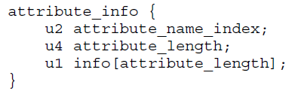
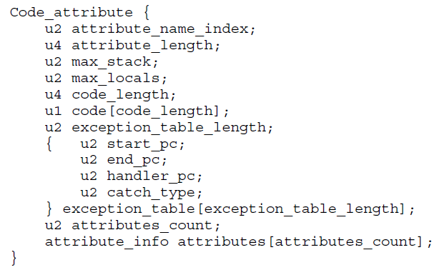
ca | fe | ba | be | 00 | 00 | 00 | 3a | 00 | 14 | 0a | 00 | 02 | 00 | 03 | 07
00 | 04 | 0c | 00 | 05 | 00 | 06 | 01 | 00 | 10 | 6a | 61 | 76 | 61 | 2f | 6c
61 | 6e | 67 | 2f | 4f | 62 | 6a | 65 | 63 | 74 | 01 | 00 | 06 | 3c | 69 | 6e
69 | 74 | 3e | 01 | 00 | 03 | 28 | 29 | 56 | 09 | 00 | 08 | 00 | 09 | 07 | 00
0a | 0c | 00 | 0b | 00 | 0c | 01 | 00 | 04 | 44 | 65 | 6d | 6f | 01 | 00 | 01
6e | 01 | 00 | 01 | 49 | 01 | 00 | 04 | 43 | 6f | 64 | 65 | 01 | 00 | 0f | 4c
69 | 6e | 65 | 4e | 75 | 6d | 62 | 65 | 72 | 54 | 61 | 62 | 6c | 65 | 01 | 00
03 | 61 | 64 | 64 | 01 | 00 | 05 | 28 | 49 | 49 | 29 | 49 | 01 | 00 | 05 | 6d
69 | 6e | 75 | 73 | 01 | 00 | 0a | 53 | 6f | 75 | 72 | 63 | 65 | 46 | 69 | 6c
65 | 01 | 00 | 09 | 44 | 65 | 6d | 6f | 2e | 6a | 61 | 76 | 61 | 00 | 21 | 00
08 | 00 | 02 | 00 | 00 | 00 | 01 | 00 | 02 | 00 | 0b | 00 | 0c | 00 | 00 | 00
03 | 00 | 01 | 00 | 05 | 00 | 06 | 00 | 01 | 00 | 0d | 00 | 00 | 00 | 26 | 00
02 | 00 | 01 | 00 | 00 | 00 | 0a | 2a | b7 | 00 | 01 | 2a | 08 | b5 | 00 | 07
b1 | 00 | 00 | 00 | 01 | 00 | 0e | 00 | 00 | 00 | 0a | 00 | 02 | 00 | 00 | 00
01 | 00 | 04 | 00 | 02 | 00 | 02 | 00 | 0f | 00 | 10 | 00 | 01 | 00 | 0d | 00
00 | 00 | 22 | 00 | 02 | 00 | 04 | 00 | 00 | 00 | 06 | 1b | 1c | 60 | 3e | 1d
ac | 00 | 00 | 00 | 01 | 00 | 0e | 00 | 00 | 00 | 0a | 00 | 02 | 00 | 00 | 00
05 | 00 | 04 | 00 | 06 | 00 | 04 | 00 | 11 | 00 | 10 | 00 | 01 | 00 | 0d | 00
00 | 00 | 22 | 00 | 02 | 00 | 04 | 00 | 00 | 00 | 06 | 1b | 1c | 64 | 3e | 1d
ac | 00 | 00 | 00 | 01 | 00 | 0e | 00 | 00 | 00 | 0a | 00 | 02 | 00 | 00 | 00
0a | 00 | 04 | 00 | 0b | 00 | 01 | 00 | 12 | 00 | 00 | 00 | 02 | 00 | 13 | 0a
Method_1.Code
Attribute Name Index: 0x000d = 13
#13 = Utf8 Code
Attribute Length: 0x00000026 = 38

Slide 36
ca | fe | ba | be | 00 | 00 | 00 | 3a | 00 | 14 | 0a | 00 | 02 | 00 | 03 | 07
00 | 04 | 0c | 00 | 05 | 00 | 06 | 01 | 00 | 10 | 6a | 61 | 76 | 61 | 2f | 6c
61 | 6e | 67 | 2f | 4f | 62 | 6a | 65 | 63 | 74 | 01 | 00 | 06 | 3c | 69 | 6e
69 | 74 | 3e | 01 | 00 | 03 | 28 | 29 | 56 | 09 | 00 | 08 | 00 | 09 | 07 | 00
0a | 0c | 00 | 0b | 00 | 0c | 01 | 00 | 04 | 44 | 65 | 6d | 6f | 01 | 00 | 01
6e | 01 | 00 | 01 | 49 | 01 | 00 | 04 | 43 | 6f | 64 | 65 | 01 | 00 | 0f | 4c
69 | 6e | 65 | 4e | 75 | 6d | 62 | 65 | 72 | 54 | 61 | 62 | 6c | 65 | 01 | 00
03 | 61 | 64 | 64 | 01 | 00 | 05 | 28 | 49 | 49 | 29 | 49 | 01 | 00 | 05 | 6d
69 | 6e | 75 | 73 | 01 | 00 | 0a | 53 | 6f | 75 | 72 | 63 | 65 | 46 | 69 | 6c
65 | 01 | 00 | 09 | 44 | 65 | 6d | 6f | 2e | 6a | 61 | 76 | 61 | 00 | 21 | 00
08 | 00 | 02 | 00 | 00 | 00 | 01 | 00 | 02 | 00 | 0b | 00 | 0c | 00 | 00 | 00
03 | 00 | 01 | 00 | 05 | 00 | 06 | 00 | 01 | 00 | 0d | 00 | 00 | 00 | 26 | 00
02 | 00 | 01 | 00 | 00 | 00 | 0a | 2a | b7 | 00 | 01 | 2a | 08 | b5 | 00 | 07
b1 | 00 | 00 | 00 | 01 | 00 | 0e | 00 | 00 | 00 | 0a | 00 | 02 | 00 | 00 | 00
01 | 00 | 04 | 00 | 02 | 00 | 02 | 00 | 0f | 00 | 10 | 00 | 01 | 00 | 0d | 00
00 | 00 | 22 | 00 | 02 | 00 | 04 | 00 | 00 | 00 | 06 | 1b | 1c | 60 | 3e | 1d
ac | 00 | 00 | 00 | 01 | 00 | 0e | 00 | 00 | 00 | 0a | 00 | 02 | 00 | 00 | 00
05 | 00 | 04 | 00 | 06 | 00 | 04 | 00 | 11 | 00 | 10 | 00 | 01 | 00 | 0d | 00
00 | 00 | 22 | 00 | 02 | 00 | 04 | 00 | 00 | 00 | 06 | 1b | 1c | 64 | 3e | 1d
ac | 00 | 00 | 00 | 01 | 00 | 0e | 00 | 00 | 00 | 0a | 00 | 02 | 00 | 00 | 00
0a | 00 | 04 | 00 | 0b | 00 | 01 | 00 | 12 | 00 | 00 | 00 | 02 | 00 | 13 | 0a
Method_1.Code
Max Stack: 0x0002 = 2
Max Locals: 0x0001 = 1
Code Length: 0x0000000a = 10
Code: 2a b7 00 01 2a 08 b5 00 07 b1

Slide 37
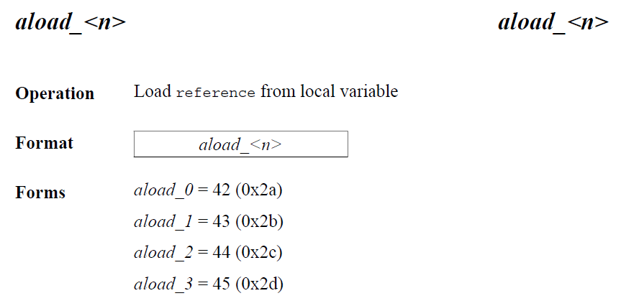
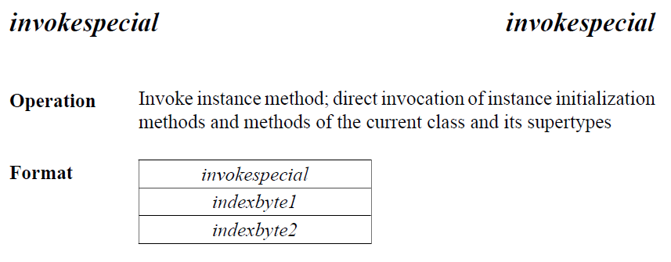
ca | fe | ba | be | 00 | 00 | 00 | 3a | 00 | 14 | 0a | 00 | 02 | 00 | 03 | 07
00 | 04 | 0c | 00 | 05 | 00 | 06 | 01 | 00 | 10 | 6a | 61 | 76 | 61 | 2f | 6c
61 | 6e | 67 | 2f | 4f | 62 | 6a | 65 | 63 | 74 | 01 | 00 | 06 | 3c | 69 | 6e
69 | 74 | 3e | 01 | 00 | 03 | 28 | 29 | 56 | 09 | 00 | 08 | 00 | 09 | 07 | 00
0a | 0c | 00 | 0b | 00 | 0c | 01 | 00 | 04 | 44 | 65 | 6d | 6f | 01 | 00 | 01
6e | 01 | 00 | 01 | 49 | 01 | 00 | 04 | 43 | 6f | 64 | 65 | 01 | 00 | 0f | 4c
69 | 6e | 65 | 4e | 75 | 6d | 62 | 65 | 72 | 54 | 61 | 62 | 6c | 65 | 01 | 00
03 | 61 | 64 | 64 | 01 | 00 | 05 | 28 | 49 | 49 | 29 | 49 | 01 | 00 | 05 | 6d
69 | 6e | 75 | 73 | 01 | 00 | 0a | 53 | 6f | 75 | 72 | 63 | 65 | 46 | 69 | 6c
65 | 01 | 00 | 09 | 44 | 65 | 6d | 6f | 2e | 6a | 61 | 76 | 61 | 00 | 21 | 00
08 | 00 | 02 | 00 | 00 | 00 | 01 | 00 | 02 | 00 | 0b | 00 | 0c | 00 | 00 | 00
03 | 00 | 01 | 00 | 05 | 00 | 06 | 00 | 01 | 00 | 0d | 00 | 00 | 00 | 26 | 00
02 | 00 | 01 | 00 | 00 | 00 | 0a | 2a | b7 | 00 | 01 | 2a | 08 | b5 | 00 | 07
b1 | 00 | 00 | 00 | 01 | 00 | 0e | 00 | 00 | 00 | 0a | 00 | 02 | 00 | 00 | 00
01 | 00 | 04 | 00 | 02 | 00 | 02 | 00 | 0f | 00 | 10 | 00 | 01 | 00 | 0d | 00
00 | 00 | 22 | 00 | 02 | 00 | 04 | 00 | 00 | 00 | 06 | 1b | 1c | 60 | 3e | 1d
ac | 00 | 00 | 00 | 01 | 00 | 0e | 00 | 00 | 00 | 0a | 00 | 02 | 00 | 00 | 00
05 | 00 | 04 | 00 | 06 | 00 | 04 | 00 | 11 | 00 | 10 | 00 | 01 | 00 | 0d | 00
00 | 00 | 22 | 00 | 02 | 00 | 04 | 00 | 00 | 00 | 06 | 1b | 1c | 64 | 3e | 1d
ac | 00 | 00 | 00 | 01 | 00 | 0e | 00 | 00 | 00 | 0a | 00 | 02 | 00 | 00 | 00
0a | 00 | 04 | 00 | 0b | 00 | 01 | 00 | 12 | 00 | 00 | 00 | 02 | 00 | 13 | 0a
Method_1.Code
Code: 2a b7 00 01 2a 08 b5 00 07 b1
0: | 2a | aload_0
1: | b7 00 01 | invokespecial #1
4: | 2a | aload_0
5: | 08 | iconst_5
6: | b5 00 07 | putfield #7
9: | b1 | return
#1 = Methodref #2.#3
// java/lang/Object.“<init>”:()V

Slide 38
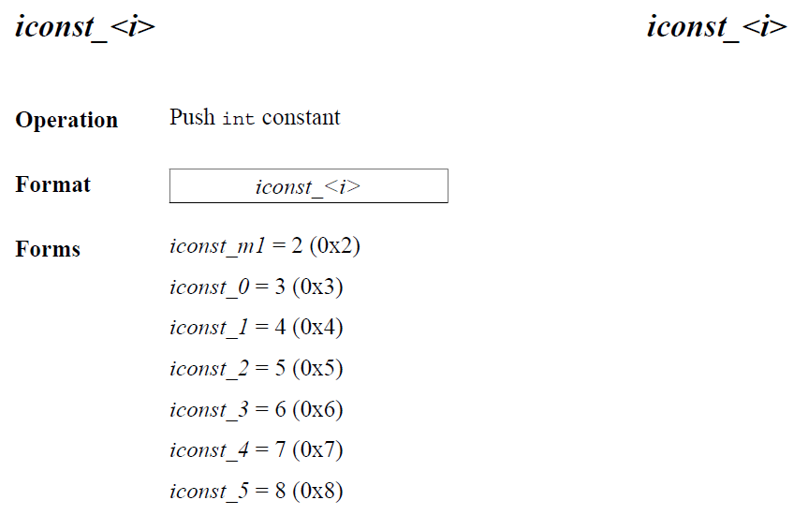
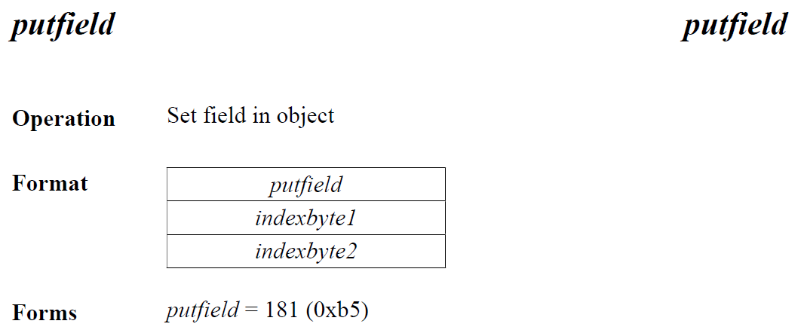
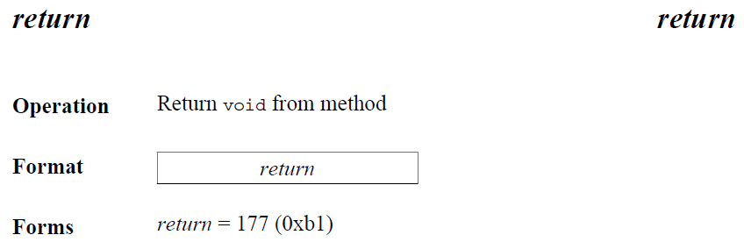
ca | fe | ba | be | 00 | 00 | 00 | 3a | 00 | 14 | 0a | 00 | 02 | 00 | 03 | 07
00 | 04 | 0c | 00 | 05 | 00 | 06 | 01 | 00 | 10 | 6a | 61 | 76 | 61 | 2f | 6c
61 | 6e | 67 | 2f | 4f | 62 | 6a | 65 | 63 | 74 | 01 | 00 | 06 | 3c | 69 | 6e
69 | 74 | 3e | 01 | 00 | 03 | 28 | 29 | 56 | 09 | 00 | 08 | 00 | 09 | 07 | 00
0a | 0c | 00 | 0b | 00 | 0c | 01 | 00 | 04 | 44 | 65 | 6d | 6f | 01 | 00 | 01
6e | 01 | 00 | 01 | 49 | 01 | 00 | 04 | 43 | 6f | 64 | 65 | 01 | 00 | 0f | 4c
69 | 6e | 65 | 4e | 75 | 6d | 62 | 65 | 72 | 54 | 61 | 62 | 6c | 65 | 01 | 00
03 | 61 | 64 | 64 | 01 | 00 | 05 | 28 | 49 | 49 | 29 | 49 | 01 | 00 | 05 | 6d
69 | 6e | 75 | 73 | 01 | 00 | 0a | 53 | 6f | 75 | 72 | 63 | 65 | 46 | 69 | 6c
65 | 01 | 00 | 09 | 44 | 65 | 6d | 6f | 2e | 6a | 61 | 76 | 61 | 00 | 21 | 00
08 | 00 | 02 | 00 | 00 | 00 | 01 | 00 | 02 | 00 | 0b | 00 | 0c | 00 | 00 | 00
03 | 00 | 01 | 00 | 05 | 00 | 06 | 00 | 01 | 00 | 0d | 00 | 00 | 00 | 26 | 00
02 | 00 | 01 | 00 | 00 | 00 | 0a | 2a | b7 | 00 | 01 | 2a | 08 | b5 | 00 | 07
b1 | 00 | 00 | 00 | 01 | 00 | 0e | 00 | 00 | 00 | 0a | 00 | 02 | 00 | 00 | 00
01 | 00 | 04 | 00 | 02 | 00 | 02 | 00 | 0f | 00 | 10 | 00 | 01 | 00 | 0d | 00
00 | 00 | 22 | 00 | 02 | 00 | 04 | 00 | 00 | 00 | 06 | 1b | 1c | 60 | 3e | 1d
ac | 00 | 00 | 00 | 01 | 00 | 0e | 00 | 00 | 00 | 0a | 00 | 02 | 00 | 00 | 00
05 | 00 | 04 | 00 | 06 | 00 | 04 | 00 | 11 | 00 | 10 | 00 | 01 | 00 | 0d | 00
00 | 00 | 22 | 00 | 02 | 00 | 04 | 00 | 00 | 00 | 06 | 1b | 1c | 64 | 3e | 1d
ac | 00 | 00 | 00 | 01 | 00 | 0e | 00 | 00 | 00 | 0a | 00 | 02 | 00 | 00 | 00
0a | 00 | 04 | 00 | 0b | 00 | 01 | 00 | 12 | 00 | 00 | 00 | 02 | 00 | 13 | 0a
Method_1.Code
Code: 2a b7 00 01 2a 08 b5 00 07 b1
0: | 2a | aload_0
1: | b7 00 01 | invokespecial #1
4: | 2a | aload_0
5: | 08 | iconst_5
6: | b5 00 07 | putfield #7
9: | b1 | return
#7 = Fieldref #8.#9
// Demo.n:I

Slide 39
ca | fe | ba | be | 00 | 00 | 00 | 3a | 00 | 14 | 0a | 00 | 02 | 00 | 03 | 07
00 | 04 | 0c | 00 | 05 | 00 | 06 | 01 | 00 | 10 | 6a | 61 | 76 | 61 | 2f | 6c
61 | 6e | 67 | 2f | 4f | 62 | 6a | 65 | 63 | 74 | 01 | 00 | 06 | 3c | 69 | 6e
69 | 74 | 3e | 01 | 00 | 03 | 28 | 29 | 56 | 09 | 00 | 08 | 00 | 09 | 07 | 00
0a | 0c | 00 | 0b | 00 | 0c | 01 | 00 | 04 | 44 | 65 | 6d | 6f | 01 | 00 | 01
6e | 01 | 00 | 01 | 49 | 01 | 00 | 04 | 43 | 6f | 64 | 65 | 01 | 00 | 0f | 4c
69 | 6e | 65 | 4e | 75 | 6d | 62 | 65 | 72 | 54 | 61 | 62 | 6c | 65 | 01 | 00
03 | 61 | 64 | 64 | 01 | 00 | 05 | 28 | 49 | 49 | 29 | 49 | 01 | 00 | 05 | 6d
69 | 6e | 75 | 73 | 01 | 00 | 0a | 53 | 6f | 75 | 72 | 63 | 65 | 46 | 69 | 6c
65 | 01 | 00 | 09 | 44 | 65 | 6d | 6f | 2e | 6a | 61 | 76 | 61 | 00 | 21 | 00
08 | 00 | 02 | 00 | 00 | 00 | 01 | 00 | 02 | 00 | 0b | 00 | 0c | 00 | 00 | 00
03 | 00 | 01 | 00 | 05 | 00 | 06 | 00 | 01 | 00 | 0d | 00 | 00 | 00 | 26 | 00
02 | 00 | 01 | 00 | 00 | 00 | 0a | 2a | b7 | 00 | 01 | 2a | 08 | b5 | 00 | 07
b1 | 00 | 00 | 00 | 01 | 00 | 0e | 00 | 00 | 00 | 0a | 00 | 02 | 00 | 00 | 00
01 | 00 | 04 | 00 | 02 | 00 | 02 | 00 | 0f | 00 | 10 | 00 | 01 | 00 | 0d | 00
00 | 00 | 22 | 00 | 02 | 00 | 04 | 00 | 00 | 00 | 06 | 1b | 1c | 60 | 3e | 1d
ac | 00 | 00 | 00 | 01 | 00 | 0e | 00 | 00 | 00 | 0a | 00 | 02 | 00 | 00 | 00
05 | 00 | 04 | 00 | 06 | 00 | 04 | 00 | 11 | 00 | 10 | 00 | 01 | 00 | 0d | 00
00 | 00 | 22 | 00 | 02 | 00 | 04 | 00 | 00 | 00 | 06 | 1b | 1c | 64 | 3e | 1d
ac | 00 | 00 | 00 | 01 | 00 | 0e | 00 | 00 | 00 | 0a | 00 | 02 | 00 | 00 | 00
0a | 00 | 04 | 00 | 0b | 00 | 01 | 00 | 12 | 00 | 00 | 00 | 02 | 00 | 13 | 0a
Method_1.Code
Exception Table Length: 0x0000 = 0
Attributes Count: 0x0001 = 1
Attributes: 00 0e 00 ... 02

Slide 40
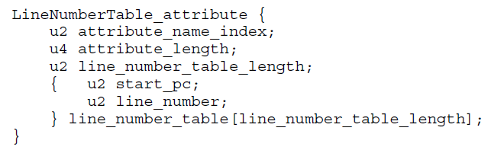
ca | fe | ba | be | 00 | 00 | 00 | 3a | 00 | 14 | 0a | 00 | 02 | 00 | 03 | 07
00 | 04 | 0c | 00 | 05 | 00 | 06 | 01 | 00 | 10 | 6a | 61 | 76 | 61 | 2f | 6c
61 | 6e | 67 | 2f | 4f | 62 | 6a | 65 | 63 | 74 | 01 | 00 | 06 | 3c | 69 | 6e
69 | 74 | 3e | 01 | 00 | 03 | 28 | 29 | 56 | 09 | 00 | 08 | 00 | 09 | 07 | 00
0a | 0c | 00 | 0b | 00 | 0c | 01 | 00 | 04 | 44 | 65 | 6d | 6f | 01 | 00 | 01
6e | 01 | 00 | 01 | 49 | 01 | 00 | 04 | 43 | 6f | 64 | 65 | 01 | 00 | 0f | 4c
69 | 6e | 65 | 4e | 75 | 6d | 62 | 65 | 72 | 54 | 61 | 62 | 6c | 65 | 01 | 00
03 | 61 | 64 | 64 | 01 | 00 | 05 | 28 | 49 | 49 | 29 | 49 | 01 | 00 | 05 | 6d
69 | 6e | 75 | 73 | 01 | 00 | 0a | 53 | 6f | 75 | 72 | 63 | 65 | 46 | 69 | 6c
65 | 01 | 00 | 09 | 44 | 65 | 6d | 6f | 2e | 6a | 61 | 76 | 61 | 00 | 21 | 00
08 | 00 | 02 | 00 | 00 | 00 | 01 | 00 | 02 | 00 | 0b | 00 | 0c | 00 | 00 | 00
03 | 00 | 01 | 00 | 05 | 00 | 06 | 00 | 01 | 00 | 0d | 00 | 00 | 00 | 26 | 00
02 | 00 | 01 | 00 | 00 | 00 | 0a | 2a | b7 | 00 | 01 | 2a | 08 | b5 | 00 | 07
b1 | 00 | 00 | 00 | 01 | 00 | 0e | 00 | 00 | 00 | 0a | 00 | 02 | 00 | 00 | 00
01 | 00 | 04 | 00 | 02 | 00 | 02 | 00 | 0f | 00 | 10 | 00 | 01 | 00 | 0d | 00
00 | 00 | 22 | 00 | 02 | 00 | 04 | 00 | 00 | 00 | 06 | 1b | 1c | 60 | 3e | 1d
ac | 00 | 00 | 00 | 01 | 00 | 0e | 00 | 00 | 00 | 0a | 00 | 02 | 00 | 00 | 00
05 | 00 | 04 | 00 | 06 | 00 | 04 | 00 | 11 | 00 | 10 | 00 | 01 | 00 | 0d | 00
00 | 00 | 22 | 00 | 02 | 00 | 04 | 00 | 00 | 00 | 06 | 1b | 1c | 64 | 3e | 1d
ac | 00 | 00 | 00 | 01 | 00 | 0e | 00 | 00 | 00 | 0a | 00 | 02 | 00 | 00 | 00
0a | 00 | 04 | 00 | 0b | 00 | 01 | 00 | 12 | 00 | 00 | 00 | 02 | 00 | 13 | 0a
Method_1.Code.LineNumberTable
Attribute Name Index: 0x000e = 14
#14 = Utf8 LineNumberTable
Attribute Length: 0x0000000a = 10
Line Number Table Length:0x0002 = 2
Line Number Table: 00 00 00 01 00 04 00 02
line 1: 0
line 2: 4

Slide 41
ca | fe | ba | be | 00 | 00 | 00 | 3a | 00 | 14 | 0a | 00 | 02 | 00 | 03 | 07
00 | 04 | 0c | 00 | 05 | 00 | 06 | 01 | 00 | 10 | 6a | 61 | 76 | 61 | 2f | 6c
61 | 6e | 67 | 2f | 4f | 62 | 6a | 65 | 63 | 74 | 01 | 00 | 06 | 3c | 69 | 6e
69 | 74 | 3e | 01 | 00 | 03 | 28 | 29 | 56 | 09 | 00 | 08 | 00 | 09 | 07 | 00
0a | 0c | 00 | 0b | 00 | 0c | 01 | 00 | 04 | 44 | 65 | 6d | 6f | 01 | 00 | 01
6e | 01 | 00 | 01 | 49 | 01 | 00 | 04 | 43 | 6f | 64 | 65 | 01 | 00 | 0f | 4c
69 | 6e | 65 | 4e | 75 | 6d | 62 | 65 | 72 | 54 | 61 | 62 | 6c | 65 | 01 | 00
03 | 61 | 64 | 64 | 01 | 00 | 05 | 28 | 49 | 49 | 29 | 49 | 01 | 00 | 05 | 6d
69 | 6e | 75 | 73 | 01 | 00 | 0a | 53 | 6f | 75 | 72 | 63 | 65 | 46 | 69 | 6c
65 | 01 | 00 | 09 | 44 | 65 | 6d | 6f | 2e | 6a | 61 | 76 | 61 | 00 | 21 | 00
08 | 00 | 02 | 00 | 00 | 00 | 01 | 00 | 02 | 00 | 0b | 00 | 0c | 00 | 00 | 00
03 | 00 | 01 | 00 | 05 | 00 | 06 | 00 | 01 | 00 | 0d | 00 | 00 | 00 | 26 | 00
02 | 00 | 01 | 00 | 00 | 00 | 0a | 2a | b7 | 00 | 01 | 2a | 08 | b5 | 00 | 07
b1 | 00 | 00 | 00 | 01 | 00 | 0e | 00 | 00 | 00 | 0a | 00 | 02 | 00 | 00 | 00
01 | 00 | 04 | 00 | 02 | 00 | 02 | 00 | 0f | 00 | 10 | 00 | 01 | 00 | 0d | 00
00 | 00 | 22 | 00 | 02 | 00 | 04 | 00 | 00 | 00 | 06 | 1b | 1c | 60 | 3e | 1d
ac | 00 | 00 | 00 | 01 | 00 | 0e | 00 | 00 | 00 | 0a | 00 | 02 | 00 | 00 | 00
05 | 00 | 04 | 00 | 06 | 00 | 04 | 00 | 11 | 00 | 10 | 00 | 01 | 00 | 0d | 00
00 | 00 | 22 | 00 | 02 | 00 | 04 | 00 | 00 | 00 | 06 | 1b | 1c | 64 | 3e | 1d
ac | 00 | 00 | 00 | 01 | 00 | 0e | 00 | 00 | 00 | 0a | 00 | 02 | 00 | 00 | 00
0a | 00 | 04 | 00 | 0b | 00 | 01 | 00 | 12 | 00 | 00 | 00 | 02 | 00 | 13 | 0a
Method_1
public Demo();
descriptor: ()V
flags: (0x0001) ACC_PUBLIC
Code:
stack=2, locals=1, args_size=1
0: aload_0
1: invokespecial #1
4: aload_0
5: iconst_5
6: putfield #7
9: return
LineNumberTable:
line 1: 0
line 2: 4
// #1 Method java/lang/Object."<init>":()V
// #7 Field n:I

Slide 42
Methods_2

Slide 43
ca | fe | ba | be | 00 | 00 | 00 | 3a | 00 | 14 | 0a | 00 | 02 | 00 | 03 | 07
00 | 04 | 0c | 00 | 05 | 00 | 06 | 01 | 00 | 10 | 6a | 61 | 76 | 61 | 2f | 6c
61 | 6e | 67 | 2f | 4f | 62 | 6a | 65 | 63 | 74 | 01 | 00 | 06 | 3c | 69 | 6e
69 | 74 | 3e | 01 | 00 | 03 | 28 | 29 | 56 | 09 | 00 | 08 | 00 | 09 | 07 | 00
0a | 0c | 00 | 0b | 00 | 0c | 01 | 00 | 04 | 44 | 65 | 6d | 6f | 01 | 00 | 01
6e | 01 | 00 | 01 | 49 | 01 | 00 | 04 | 43 | 6f | 64 | 65 | 01 | 00 | 0f | 4c
69 | 6e | 65 | 4e | 75 | 6d | 62 | 65 | 72 | 54 | 61 | 62 | 6c | 65 | 01 | 00
03 | 61 | 64 | 64 | 01 | 00 | 05 | 28 | 49 | 49 | 29 | 49 | 01 | 00 | 05 | 6d
69 | 6e | 75 | 73 | 01 | 00 | 0a | 53 | 6f | 75 | 72 | 63 | 65 | 46 | 69 | 6c
65 | 01 | 00 | 09 | 44 | 65 | 6d | 6f | 2e | 6a | 61 | 76 | 61 | 00 | 21 | 00
08 | 00 | 02 | 00 | 00 | 00 | 01 | 00 | 02 | 00 | 0b | 00 | 0c | 00 | 00 | 00
03 | 00 | 01 | 00 | 05 | 00 | 06 | 00 | 01 | 00 | 0d | 00 | 00 | 00 | 26 | 00
02 | 00 | 01 | 00 | 00 | 00 | 0a | 2a | b7 | 00 | 01 | 2a | 08 | b5 | 00 | 07
b1 | 00 | 00 | 00 | 01 | 00 | 0e | 00 | 00 | 00 | 0a | 00 | 02 | 00 | 00 | 00
01 | 00 | 04 | 00 | 02 | 00 | 02 | 00 | 0f | 00 | 10 | 00 | 01 | 00 | 0d | 00
00 | 00 | 22 | 00 | 02 | 00 | 04 | 00 | 00 | 00 | 06 | 1b | 1c | 60 | 3e | 1d
ac | 00 | 00 | 00 | 01 | 00 | 0e | 00 | 00 | 00 | 0a | 00 | 02 | 00 | 00 | 00
05 | 00 | 04 | 00 | 06 | 00 | 04 | 00 | 11 | 00 | 10 | 00 | 01 | 00 | 0d | 00
00 | 00 | 22 | 00 | 02 | 00 | 04 | 00 | 00 | 00 | 06 | 1b | 1c | 64 | 3e | 1d
ac | 00 | 00 | 00 | 01 | 00 | 0e | 00 | 00 | 00 | 0a | 00 | 02 | 00 | 00 | 00
0a | 00 | 04 | 00 | 0b | 00 | 01 | 00 | 12 | 00 | 00 | 00 | 02 | 00 | 13 | 0a
Method_2
Access Flags: 0x0002 ACC_PRIVATE
Name Index: 0x000f = 15
#15 = Utf8 add
Descriptor Index: 0x0010 = 16
#16 = Utf8 (II)I
Attributes Count: 0x0001 = 1

Slide 44
ca | fe | ba | be | 00 | 00 | 00 | 3a | 00 | 14 | 0a | 00 | 02 | 00 | 03 | 07
00 | 04 | 0c | 00 | 05 | 00 | 06 | 01 | 00 | 10 | 6a | 61 | 76 | 61 | 2f | 6c
61 | 6e | 67 | 2f | 4f | 62 | 6a | 65 | 63 | 74 | 01 | 00 | 06 | 3c | 69 | 6e
69 | 74 | 3e | 01 | 00 | 03 | 28 | 29 | 56 | 09 | 00 | 08 | 00 | 09 | 07 | 00
0a | 0c | 00 | 0b | 00 | 0c | 01 | 00 | 04 | 44 | 65 | 6d | 6f | 01 | 00 | 01
6e | 01 | 00 | 01 | 49 | 01 | 00 | 04 | 43 | 6f | 64 | 65 | 01 | 00 | 0f | 4c
69 | 6e | 65 | 4e | 75 | 6d | 62 | 65 | 72 | 54 | 61 | 62 | 6c | 65 | 01 | 00
03 | 61 | 64 | 64 | 01 | 00 | 05 | 28 | 49 | 49 | 29 | 49 | 01 | 00 | 05 | 6d
69 | 6e | 75 | 73 | 01 | 00 | 0a | 53 | 6f | 75 | 72 | 63 | 65 | 46 | 69 | 6c
65 | 01 | 00 | 09 | 44 | 65 | 6d | 6f | 2e | 6a | 61 | 76 | 61 | 00 | 21 | 00
08 | 00 | 02 | 00 | 00 | 00 | 01 | 00 | 02 | 00 | 0b | 00 | 0c | 00 | 00 | 00
03 | 00 | 01 | 00 | 05 | 00 | 06 | 00 | 01 | 00 | 0d | 00 | 00 | 00 | 26 | 00
02 | 00 | 01 | 00 | 00 | 00 | 0a | 2a | b7 | 00 | 01 | 2a | 08 | b5 | 00 | 07
b1 | 00 | 00 | 00 | 01 | 00 | 0e | 00 | 00 | 00 | 0a | 00 | 02 | 00 | 00 | 00
01 | 00 | 04 | 00 | 02 | 00 | 02 | 00 | 0f | 00 | 10 | 00 | 01 | 00 | 0d | 00
00 | 00 | 22 | 00 | 02 | 00 | 04 | 00 | 00 | 00 | 06 | 1b | 1c | 60 | 3e | 1d
ac | 00 | 00 | 00 | 01 | 00 | 0e | 00 | 00 | 00 | 0a | 00 | 02 | 00 | 00 | 00
05 | 00 | 04 | 00 | 06 | 00 | 04 | 00 | 11 | 00 | 10 | 00 | 01 | 00 | 0d | 00
00 | 00 | 22 | 00 | 02 | 00 | 04 | 00 | 00 | 00 | 06 | 1b | 1c | 64 | 3e | 1d
ac | 00 | 00 | 00 | 01 | 00 | 0e | 00 | 00 | 00 | 0a | 00 | 02 | 00 | 00 | 00
0a | 00 | 04 | 00 | 0b | 00 | 01 | 00 | 12 | 00 | 00 | 00 | 02 | 00 | 13 | 0a
Method_2.Code
Attribute Name Index: 0x000d = 13
#13 = Utf8 Code
Attribute Length: 0x00000022 = 34

Slide 45
ca | fe | ba | be | 00 | 00 | 00 | 3a | 00 | 14 | 0a | 00 | 02 | 00 | 03 | 07
00 | 04 | 0c | 00 | 05 | 00 | 06 | 01 | 00 | 10 | 6a | 61 | 76 | 61 | 2f | 6c
61 | 6e | 67 | 2f | 4f | 62 | 6a | 65 | 63 | 74 | 01 | 00 | 06 | 3c | 69 | 6e
69 | 74 | 3e | 01 | 00 | 03 | 28 | 29 | 56 | 09 | 00 | 08 | 00 | 09 | 07 | 00
0a | 0c | 00 | 0b | 00 | 0c | 01 | 00 | 04 | 44 | 65 | 6d | 6f | 01 | 00 | 01
6e | 01 | 00 | 01 | 49 | 01 | 00 | 04 | 43 | 6f | 64 | 65 | 01 | 00 | 0f | 4c
69 | 6e | 65 | 4e | 75 | 6d | 62 | 65 | 72 | 54 | 61 | 62 | 6c | 65 | 01 | 00
03 | 61 | 64 | 64 | 01 | 00 | 05 | 28 | 49 | 49 | 29 | 49 | 01 | 00 | 05 | 6d
69 | 6e | 75 | 73 | 01 | 00 | 0a | 53 | 6f | 75 | 72 | 63 | 65 | 46 | 69 | 6c
65 | 01 | 00 | 09 | 44 | 65 | 6d | 6f | 2e | 6a | 61 | 76 | 61 | 00 | 21 | 00
08 | 00 | 02 | 00 | 00 | 00 | 01 | 00 | 02 | 00 | 0b | 00 | 0c | 00 | 00 | 00
03 | 00 | 01 | 00 | 05 | 00 | 06 | 00 | 01 | 00 | 0d | 00 | 00 | 00 | 26 | 00
02 | 00 | 01 | 00 | 00 | 00 | 0a | 2a | b7 | 00 | 01 | 2a | 08 | b5 | 00 | 07
b1 | 00 | 00 | 00 | 01 | 00 | 0e | 00 | 00 | 00 | 0a | 00 | 02 | 00 | 00 | 00
01 | 00 | 04 | 00 | 02 | 00 | 02 | 00 | 0f | 00 | 10 | 00 | 01 | 00 | 0d | 00
00 | 00 | 22 | 00 | 02 | 00 | 04 | 00 | 00 | 00 | 06 | 1b | 1c | 60 | 3e | 1d
ac | 00 | 00 | 00 | 01 | 00 | 0e | 00 | 00 | 00 | 0a | 00 | 02 | 00 | 00 | 00
05 | 00 | 04 | 00 | 06 | 00 | 04 | 00 | 11 | 00 | 10 | 00 | 01 | 00 | 0d | 00
00 | 00 | 22 | 00 | 02 | 00 | 04 | 00 | 00 | 00 | 06 | 1b | 1c | 64 | 3e | 1d
ac | 00 | 00 | 00 | 01 | 00 | 0e | 00 | 00 | 00 | 0a | 00 | 02 | 00 | 00 | 00
0a | 00 | 04 | 00 | 0b | 00 | 01 | 00 | 12 | 00 | 00 | 00 | 02 | 00 | 13 | 0a
Method_2.Code
Max Stack: 0x0002 = 2
Max Locals: 0x0004 = 4
Code Length: 0x00000006 = 6
Code: 1b 1c 60 3e 1d ac

Slide 46
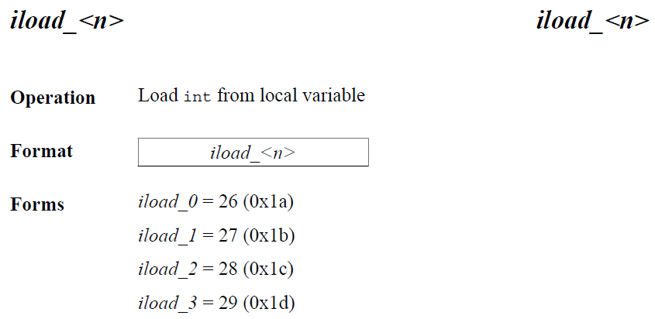
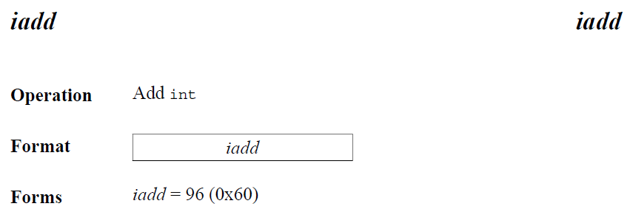
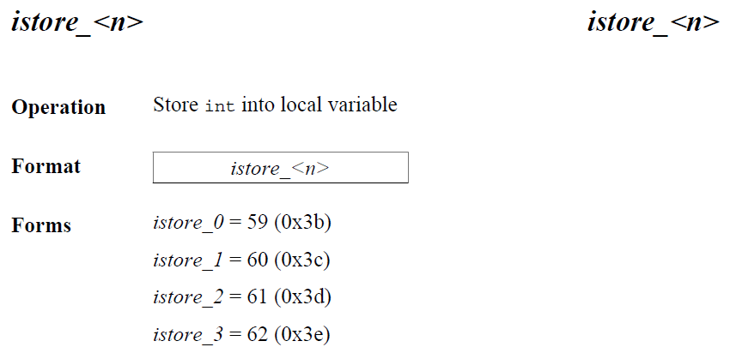
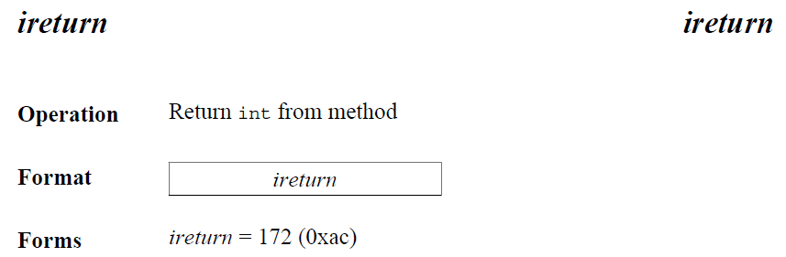
ca | fe | ba | be | 00 | 00 | 00 | 3a | 00 | 14 | 0a | 00 | 02 | 00 | 03 | 07
00 | 04 | 0c | 00 | 05 | 00 | 06 | 01 | 00 | 10 | 6a | 61 | 76 | 61 | 2f | 6c
61 | 6e | 67 | 2f | 4f | 62 | 6a | 65 | 63 | 74 | 01 | 00 | 06 | 3c | 69 | 6e
69 | 74 | 3e | 01 | 00 | 03 | 28 | 29 | 56 | 09 | 00 | 08 | 00 | 09 | 07 | 00
0a | 0c | 00 | 0b | 00 | 0c | 01 | 00 | 04 | 44 | 65 | 6d | 6f | 01 | 00 | 01
6e | 01 | 00 | 01 | 49 | 01 | 00 | 04 | 43 | 6f | 64 | 65 | 01 | 00 | 0f | 4c
69 | 6e | 65 | 4e | 75 | 6d | 62 | 65 | 72 | 54 | 61 | 62 | 6c | 65 | 01 | 00
03 | 61 | 64 | 64 | 01 | 00 | 05 | 28 | 49 | 49 | 29 | 49 | 01 | 00 | 05 | 6d
69 | 6e | 75 | 73 | 01 | 00 | 0a | 53 | 6f | 75 | 72 | 63 | 65 | 46 | 69 | 6c
65 | 01 | 00 | 09 | 44 | 65 | 6d | 6f | 2e | 6a | 61 | 76 | 61 | 00 | 21 | 00
08 | 00 | 02 | 00 | 00 | 00 | 01 | 00 | 02 | 00 | 0b | 00 | 0c | 00 | 00 | 00
03 | 00 | 01 | 00 | 05 | 00 | 06 | 00 | 01 | 00 | 0d | 00 | 00 | 00 | 26 | 00
02 | 00 | 01 | 00 | 00 | 00 | 0a | 2a | b7 | 00 | 01 | 2a | 08 | b5 | 00 | 07
b1 | 00 | 00 | 00 | 01 | 00 | 0e | 00 | 00 | 00 | 0a | 00 | 02 | 00 | 00 | 00
01 | 00 | 04 | 00 | 02 | 00 | 02 | 00 | 0f | 00 | 10 | 00 | 01 | 00 | 0d | 00
00 | 00 | 22 | 00 | 02 | 00 | 04 | 00 | 00 | 00 | 06 | 1b | 1c | 60 | 3e | 1d
ac | 00 | 00 | 00 | 01 | 00 | 0e | 00 | 00 | 00 | 0a | 00 | 02 | 00 | 00 | 00
05 | 00 | 04 | 00 | 06 | 00 | 04 | 00 | 11 | 00 | 10 | 00 | 01 | 00 | 0d | 00
00 | 00 | 22 | 00 | 02 | 00 | 04 | 00 | 00 | 00 | 06 | 1b | 1c | 64 | 3e | 1d
ac | 00 | 00 | 00 | 01 | 00 | 0e | 00 | 00 | 00 | 0a | 00 | 02 | 00 | 00 | 00
0a | 00 | 04 | 00 | 0b | 00 | 01 | 00 | 12 | 00 | 00 | 00 | 02 | 00 | 13 | 0a
Method_2.Code
Code: 1b 1c 60 3e 1d ac
0: | 1b | iload_1
1: | 1c | iload_2
2: | 60 | iadd
3: | 3e | istore_3
4: | 1d | iload_3
5: | ac | ireturn

Slide 47
ca | fe | ba | be | 00 | 00 | 00 | 3a | 00 | 14 | 0a | 00 | 02 | 00 | 03 | 07
00 | 04 | 0c | 00 | 05 | 00 | 06 | 01 | 00 | 10 | 6a | 61 | 76 | 61 | 2f | 6c
61 | 6e | 67 | 2f | 4f | 62 | 6a | 65 | 63 | 74 | 01 | 00 | 06 | 3c | 69 | 6e
69 | 74 | 3e | 01 | 00 | 03 | 28 | 29 | 56 | 09 | 00 | 08 | 00 | 09 | 07 | 00
0a | 0c | 00 | 0b | 00 | 0c | 01 | 00 | 04 | 44 | 65 | 6d | 6f | 01 | 00 | 01
6e | 01 | 00 | 01 | 49 | 01 | 00 | 04 | 43 | 6f | 64 | 65 | 01 | 00 | 0f | 4c
69 | 6e | 65 | 4e | 75 | 6d | 62 | 65 | 72 | 54 | 61 | 62 | 6c | 65 | 01 | 00
03 | 61 | 64 | 64 | 01 | 00 | 05 | 28 | 49 | 49 | 29 | 49 | 01 | 00 | 05 | 6d
69 | 6e | 75 | 73 | 01 | 00 | 0a | 53 | 6f | 75 | 72 | 63 | 65 | 46 | 69 | 6c
65 | 01 | 00 | 09 | 44 | 65 | 6d | 6f | 2e | 6a | 61 | 76 | 61 | 00 | 21 | 00
08 | 00 | 02 | 00 | 00 | 00 | 01 | 00 | 02 | 00 | 0b | 00 | 0c | 00 | 00 | 00
03 | 00 | 01 | 00 | 05 | 00 | 06 | 00 | 01 | 00 | 0d | 00 | 00 | 00 | 26 | 00
02 | 00 | 01 | 00 | 00 | 00 | 0a | 2a | b7 | 00 | 01 | 2a | 08 | b5 | 00 | 07
b1 | 00 | 00 | 00 | 01 | 00 | 0e | 00 | 00 | 00 | 0a | 00 | 02 | 00 | 00 | 00
01 | 00 | 04 | 00 | 02 | 00 | 02 | 00 | 0f | 00 | 10 | 00 | 01 | 00 | 0d | 00
00 | 00 | 22 | 00 | 02 | 00 | 04 | 00 | 00 | 00 | 06 | 1b | 1c | 60 | 3e | 1d
ac | 00 | 00 | 00 | 01 | 00 | 0e | 00 | 00 | 00 | 0a | 00 | 02 | 00 | 00 | 00
05 | 00 | 04 | 00 | 06 | 00 | 04 | 00 | 11 | 00 | 10 | 00 | 01 | 00 | 0d | 00
00 | 00 | 22 | 00 | 02 | 00 | 04 | 00 | 00 | 00 | 06 | 1b | 1c | 64 | 3e | 1d
ac | 00 | 00 | 00 | 01 | 00 | 0e | 00 | 00 | 00 | 0a | 00 | 02 | 00 | 00 | 00
0a | 00 | 04 | 00 | 0b | 00 | 01 | 00 | 12 | 00 | 00 | 00 | 02 | 00 | 13 | 0a
Method_2.Code
Exception Table Length: 0x0000 = 0
Attributes Count: 0x0001 = 1
Attributes: 00 0e 00 ... 06

Slide 48
ca | fe | ba | be | 00 | 00 | 00 | 3a | 00 | 14 | 0a | 00 | 02 | 00 | 03 | 07
00 | 04 | 0c | 00 | 05 | 00 | 06 | 01 | 00 | 10 | 6a | 61 | 76 | 61 | 2f | 6c
61 | 6e | 67 | 2f | 4f | 62 | 6a | 65 | 63 | 74 | 01 | 00 | 06 | 3c | 69 | 6e
69 | 74 | 3e | 01 | 00 | 03 | 28 | 29 | 56 | 09 | 00 | 08 | 00 | 09 | 07 | 00
0a | 0c | 00 | 0b | 00 | 0c | 01 | 00 | 04 | 44 | 65 | 6d | 6f | 01 | 00 | 01
6e | 01 | 00 | 01 | 49 | 01 | 00 | 04 | 43 | 6f | 64 | 65 | 01 | 00 | 0f | 4c
69 | 6e | 65 | 4e | 75 | 6d | 62 | 65 | 72 | 54 | 61 | 62 | 6c | 65 | 01 | 00
03 | 61 | 64 | 64 | 01 | 00 | 05 | 28 | 49 | 49 | 29 | 49 | 01 | 00 | 05 | 6d
69 | 6e | 75 | 73 | 01 | 00 | 0a | 53 | 6f | 75 | 72 | 63 | 65 | 46 | 69 | 6c
65 | 01 | 00 | 09 | 44 | 65 | 6d | 6f | 2e | 6a | 61 | 76 | 61 | 00 | 21 | 00
08 | 00 | 02 | 00 | 00 | 00 | 01 | 00 | 02 | 00 | 0b | 00 | 0c | 00 | 00 | 00
03 | 00 | 01 | 00 | 05 | 00 | 06 | 00 | 01 | 00 | 0d | 00 | 00 | 00 | 26 | 00
02 | 00 | 01 | 00 | 00 | 00 | 0a | 2a | b7 | 00 | 01 | 2a | 08 | b5 | 00 | 07
b1 | 00 | 00 | 00 | 01 | 00 | 0e | 00 | 00 | 00 | 0a | 00 | 02 | 00 | 00 | 00
01 | 00 | 04 | 00 | 02 | 00 | 02 | 00 | 0f | 00 | 10 | 00 | 01 | 00 | 0d | 00
00 | 00 | 22 | 00 | 02 | 00 | 04 | 00 | 00 | 00 | 06 | 1b | 1c | 60 | 3e | 1d
ac | 00 | 00 | 00 | 01 | 00 | 0e | 00 | 00 | 00 | 0a | 00 | 02 | 00 | 00 | 00
05 | 00 | 04 | 00 | 06 | 00 | 04 | 00 | 11 | 00 | 10 | 00 | 01 | 00 | 0d | 00
00 | 00 | 22 | 00 | 02 | 00 | 04 | 00 | 00 | 00 | 06 | 1b | 1c | 64 | 3e | 1d
ac | 00 | 00 | 00 | 01 | 00 | 0e | 00 | 00 | 00 | 0a | 00 | 02 | 00 | 00 | 00
0a | 00 | 04 | 00 | 0b | 00 | 01 | 00 | 12 | 00 | 00 | 00 | 02 | 00 | 13 | 0a
Method_2.Code.LineNumberTable
Attribute Name Index: 0x000e = 14
#14 = Utf8 LineNumberTable
Attribute Length: 0x0000000a = 10
Line Number Table Length:0x0002 = 2
Line Number Table: 00 00 00 05 00 04 00 06
line 5: 0
line 6: 4

Slide 49
ca | fe | ba | be | 00 | 00 | 00 | 3a | 00 | 14 | 0a | 00 | 02 | 00 | 03 | 07
00 | 04 | 0c | 00 | 05 | 00 | 06 | 01 | 00 | 10 | 6a | 61 | 76 | 61 | 2f | 6c
61 | 6e | 67 | 2f | 4f | 62 | 6a | 65 | 63 | 74 | 01 | 00 | 06 | 3c | 69 | 6e
69 | 74 | 3e | 01 | 00 | 03 | 28 | 29 | 56 | 09 | 00 | 08 | 00 | 09 | 07 | 00
0a | 0c | 00 | 0b | 00 | 0c | 01 | 00 | 04 | 44 | 65 | 6d | 6f | 01 | 00 | 01
6e | 01 | 00 | 01 | 49 | 01 | 00 | 04 | 43 | 6f | 64 | 65 | 01 | 00 | 0f | 4c
69 | 6e | 65 | 4e | 75 | 6d | 62 | 65 | 72 | 54 | 61 | 62 | 6c | 65 | 01 | 00
03 | 61 | 64 | 64 | 01 | 00 | 05 | 28 | 49 | 49 | 29 | 49 | 01 | 00 | 05 | 6d
69 | 6e | 75 | 73 | 01 | 00 | 0a | 53 | 6f | 75 | 72 | 63 | 65 | 46 | 69 | 6c
65 | 01 | 00 | 09 | 44 | 65 | 6d | 6f | 2e | 6a | 61 | 76 | 61 | 00 | 21 | 00
08 | 00 | 02 | 00 | 00 | 00 | 01 | 00 | 02 | 00 | 0b | 00 | 0c | 00 | 00 | 00
03 | 00 | 01 | 00 | 05 | 00 | 06 | 00 | 01 | 00 | 0d | 00 | 00 | 00 | 26 | 00
02 | 00 | 01 | 00 | 00 | 00 | 0a | 2a | b7 | 00 | 01 | 2a | 08 | b5 | 00 | 07
b1 | 00 | 00 | 00 | 01 | 00 | 0e | 00 | 00 | 00 | 0a | 00 | 02 | 00 | 00 | 00
01 | 00 | 04 | 00 | 02 | 00 | 02 | 00 | 0f | 00 | 10 | 00 | 01 | 00 | 0d | 00
00 | 00 | 22 | 00 | 02 | 00 | 04 | 00 | 00 | 00 | 06 | 1b | 1c | 60 | 3e | 1d
ac | 00 | 00 | 00 | 01 | 00 | 0e | 00 | 00 | 00 | 0a | 00 | 02 | 00 | 00 | 00
05 | 00 | 04 | 00 | 06 | 00 | 04 | 00 | 11 | 00 | 10 | 00 | 01 | 00 | 0d | 00
00 | 00 | 22 | 00 | 02 | 00 | 04 | 00 | 00 | 00 | 06 | 1b | 1c | 64 | 3e | 1d
ac | 00 | 00 | 00 | 01 | 00 | 0e | 00 | 00 | 00 | 0a | 00 | 02 | 00 | 00 | 00
0a | 00 | 04 | 00 | 0b | 00 | 01 | 00 | 12 | 00 | 00 | 00 | 02 | 00 | 13 | 0a
Method_2
private add(int, int);
descriptor: (II)I
flags: (0x0002) ACC_PRIVATE
Code:
stack=2, locals=4, args_size=3
0: iload_1
1: iload_2
2: iadd
3: istroe_3
4: iload_3
5: ireturn
LineNumberTable:
line 5: 0
line 6: 4

Slide 50
Methods_3

Slide 51
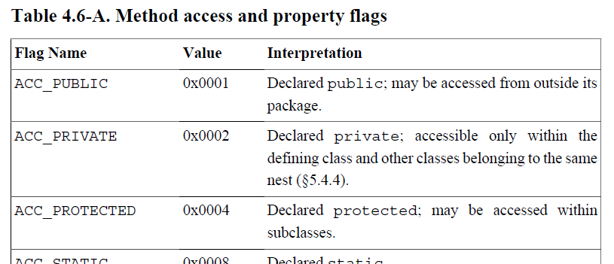
ca | fe | ba | be | 00 | 00 | 00 | 3a | 00 | 14 | 0a | 00 | 02 | 00 | 03 | 07
00 | 04 | 0c | 00 | 05 | 00 | 06 | 01 | 00 | 10 | 6a | 61 | 76 | 61 | 2f | 6c
61 | 6e | 67 | 2f | 4f | 62 | 6a | 65 | 63 | 74 | 01 | 00 | 06 | 3c | 69 | 6e
69 | 74 | 3e | 01 | 00 | 03 | 28 | 29 | 56 | 09 | 00 | 08 | 00 | 09 | 07 | 00
0a | 0c | 00 | 0b | 00 | 0c | 01 | 00 | 04 | 44 | 65 | 6d | 6f | 01 | 00 | 01
6e | 01 | 00 | 01 | 49 | 01 | 00 | 04 | 43 | 6f | 64 | 65 | 01 | 00 | 0f | 4c
69 | 6e | 65 | 4e | 75 | 6d | 62 | 65 | 72 | 54 | 61 | 62 | 6c | 65 | 01 | 00
03 | 61 | 64 | 64 | 01 | 00 | 05 | 28 | 49 | 49 | 29 | 49 | 01 | 00 | 05 | 6d
69 | 6e | 75 | 73 | 01 | 00 | 0a | 53 | 6f | 75 | 72 | 63 | 65 | 46 | 69 | 6c
65 | 01 | 00 | 09 | 44 | 65 | 6d | 6f | 2e | 6a | 61 | 76 | 61 | 00 | 21 | 00
08 | 00 | 02 | 00 | 00 | 00 | 01 | 00 | 02 | 00 | 0b | 00 | 0c | 00 | 00 | 00
03 | 00 | 01 | 00 | 05 | 00 | 06 | 00 | 01 | 00 | 0d | 00 | 00 | 00 | 26 | 00
02 | 00 | 01 | 00 | 00 | 00 | 0a | 2a | b7 | 00 | 01 | 2a | 08 | b5 | 00 | 07
b1 | 00 | 00 | 00 | 01 | 00 | 0e | 00 | 00 | 00 | 0a | 00 | 02 | 00 | 00 | 00
01 | 00 | 04 | 00 | 02 | 00 | 02 | 00 | 0f | 00 | 10 | 00 | 01 | 00 | 0d | 00
00 | 00 | 22 | 00 | 02 | 00 | 04 | 00 | 00 | 00 | 06 | 1b | 1c | 60 | 3e | 1d
ac | 00 | 00 | 00 | 01 | 00 | 0e | 00 | 00 | 00 | 0a | 00 | 02 | 00 | 00 | 00
05 | 00 | 04 | 00 | 06 | 00 | 04 | 00 | 11 | 00 | 10 | 00 | 01 | 00 | 0d | 00
00 | 00 | 22 | 00 | 02 | 00 | 04 | 00 | 00 | 00 | 06 | 1b | 1c | 64 | 3e | 1d
ac | 00 | 00 | 00 | 01 | 00 | 0e | 00 | 00 | 00 | 0a | 00 | 02 | 00 | 00 | 00
0a | 00 | 04 | 00 | 0b | 00 | 01 | 00 | 12 | 00 | 00 | 00 | 02 | 00 | 13 | 0a
Method_3
Access Flags: 0x0004 ACC_PROTECTED
Name Index: 0x0011 = 17
#17 = Utf8 minus
Descriptor Index: 0x0010 = 16
#16 = Utf8 (II)I
Attributes Count: 0x0001 = 1

Slide 52
ca | fe | ba | be | 00 | 00 | 00 | 3a | 00 | 14 | 0a | 00 | 02 | 00 | 03 | 07
00 | 04 | 0c | 00 | 05 | 00 | 06 | 01 | 00 | 10 | 6a | 61 | 76 | 61 | 2f | 6c
61 | 6e | 67 | 2f | 4f | 62 | 6a | 65 | 63 | 74 | 01 | 00 | 06 | 3c | 69 | 6e
69 | 74 | 3e | 01 | 00 | 03 | 28 | 29 | 56 | 09 | 00 | 08 | 00 | 09 | 07 | 00
0a | 0c | 00 | 0b | 00 | 0c | 01 | 00 | 04 | 44 | 65 | 6d | 6f | 01 | 00 | 01
6e | 01 | 00 | 01 | 49 | 01 | 00 | 04 | 43 | 6f | 64 | 65 | 01 | 00 | 0f | 4c
69 | 6e | 65 | 4e | 75 | 6d | 62 | 65 | 72 | 54 | 61 | 62 | 6c | 65 | 01 | 00
03 | 61 | 64 | 64 | 01 | 00 | 05 | 28 | 49 | 49 | 29 | 49 | 01 | 00 | 05 | 6d
69 | 6e | 75 | 73 | 01 | 00 | 0a | 53 | 6f | 75 | 72 | 63 | 65 | 46 | 69 | 6c
65 | 01 | 00 | 09 | 44 | 65 | 6d | 6f | 2e | 6a | 61 | 76 | 61 | 00 | 21 | 00
08 | 00 | 02 | 00 | 00 | 00 | 01 | 00 | 02 | 00 | 0b | 00 | 0c | 00 | 00 | 00
03 | 00 | 01 | 00 | 05 | 00 | 06 | 00 | 01 | 00 | 0d | 00 | 00 | 00 | 26 | 00
02 | 00 | 01 | 00 | 00 | 00 | 0a | 2a | b7 | 00 | 01 | 2a | 08 | b5 | 00 | 07
b1 | 00 | 00 | 00 | 01 | 00 | 0e | 00 | 00 | 00 | 0a | 00 | 02 | 00 | 00 | 00
01 | 00 | 04 | 00 | 02 | 00 | 02 | 00 | 0f | 00 | 10 | 00 | 01 | 00 | 0d | 00
00 | 00 | 22 | 00 | 02 | 00 | 04 | 00 | 00 | 00 | 06 | 1b | 1c | 60 | 3e | 1d
ac | 00 | 00 | 00 | 01 | 00 | 0e | 00 | 00 | 00 | 0a | 00 | 02 | 00 | 00 | 00
05 | 00 | 04 | 00 | 06 | 00 | 04 | 00 | 11 | 00 | 10 | 00 | 01 | 00 | 0d | 00
00 | 00 | 22 | 00 | 02 | 00 | 04 | 00 | 00 | 00 | 06 | 1b | 1c | 64 | 3e | 1d
ac | 00 | 00 | 00 | 01 | 00 | 0e | 00 | 00 | 00 | 0a | 00 | 02 | 00 | 00 | 00
0a | 00 | 04 | 00 | 0b | 00 | 01 | 00 | 12 | 00 | 00 | 00 | 02 | 00 | 13 | 0a
Method_3.Code
Attribute Name Index: 0x000d = 13
#13 = Utf8 Code
Attribute Length: 0x00000022 = 34

Slide 53
ca | fe | ba | be | 00 | 00 | 00 | 3a | 00 | 14 | 0a | 00 | 02 | 00 | 03 | 07
00 | 04 | 0c | 00 | 05 | 00 | 06 | 01 | 00 | 10 | 6a | 61 | 76 | 61 | 2f | 6c
61 | 6e | 67 | 2f | 4f | 62 | 6a | 65 | 63 | 74 | 01 | 00 | 06 | 3c | 69 | 6e
69 | 74 | 3e | 01 | 00 | 03 | 28 | 29 | 56 | 09 | 00 | 08 | 00 | 09 | 07 | 00
0a | 0c | 00 | 0b | 00 | 0c | 01 | 00 | 04 | 44 | 65 | 6d | 6f | 01 | 00 | 01
6e | 01 | 00 | 01 | 49 | 01 | 00 | 04 | 43 | 6f | 64 | 65 | 01 | 00 | 0f | 4c
69 | 6e | 65 | 4e | 75 | 6d | 62 | 65 | 72 | 54 | 61 | 62 | 6c | 65 | 01 | 00
03 | 61 | 64 | 64 | 01 | 00 | 05 | 28 | 49 | 49 | 29 | 49 | 01 | 00 | 05 | 6d
69 | 6e | 75 | 73 | 01 | 00 | 0a | 53 | 6f | 75 | 72 | 63 | 65 | 46 | 69 | 6c
65 | 01 | 00 | 09 | 44 | 65 | 6d | 6f | 2e | 6a | 61 | 76 | 61 | 00 | 21 | 00
08 | 00 | 02 | 00 | 00 | 00 | 01 | 00 | 02 | 00 | 0b | 00 | 0c | 00 | 00 | 00
03 | 00 | 01 | 00 | 05 | 00 | 06 | 00 | 01 | 00 | 0d | 00 | 00 | 00 | 26 | 00
02 | 00 | 01 | 00 | 00 | 00 | 0a | 2a | b7 | 00 | 01 | 2a | 08 | b5 | 00 | 07
b1 | 00 | 00 | 00 | 01 | 00 | 0e | 00 | 00 | 00 | 0a | 00 | 02 | 00 | 00 | 00
01 | 00 | 04 | 00 | 02 | 00 | 02 | 00 | 0f | 00 | 10 | 00 | 01 | 00 | 0d | 00
00 | 00 | 22 | 00 | 02 | 00 | 04 | 00 | 00 | 00 | 06 | 1b | 1c | 60 | 3e | 1d
ac | 00 | 00 | 00 | 01 | 00 | 0e | 00 | 00 | 00 | 0a | 00 | 02 | 00 | 00 | 00
05 | 00 | 04 | 00 | 06 | 00 | 04 | 00 | 11 | 00 | 10 | 00 | 01 | 00 | 0d | 00
00 | 00 | 22 | 00 | 02 | 00 | 04 | 00 | 00 | 00 | 06 | 1b | 1c | 64 | 3e | 1d
ac | 00 | 00 | 00 | 01 | 00 | 0e | 00 | 00 | 00 | 0a | 00 | 02 | 00 | 00 | 00
0a | 00 | 04 | 00 | 0b | 00 | 01 | 00 | 12 | 00 | 00 | 00 | 02 | 00 | 13 | 0a
Method_3.Code
Max Stack: 0x0002 = 2
Max Locals: 0x0004 = 4
Code Length: 0x00000006 = 6
Code: 1b 1c 64 3e 1d ac

Slide 54
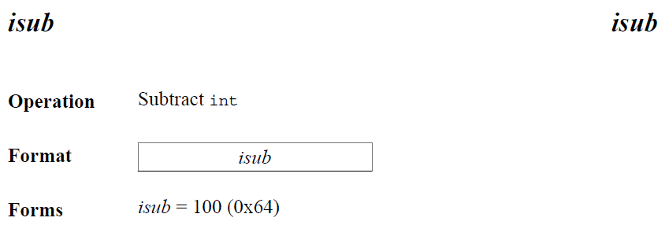
ca | fe | ba | be | 00 | 00 | 00 | 3a | 00 | 14 | 0a | 00 | 02 | 00 | 03 | 07
00 | 04 | 0c | 00 | 05 | 00 | 06 | 01 | 00 | 10 | 6a | 61 | 76 | 61 | 2f | 6c
61 | 6e | 67 | 2f | 4f | 62 | 6a | 65 | 63 | 74 | 01 | 00 | 06 | 3c | 69 | 6e
69 | 74 | 3e | 01 | 00 | 03 | 28 | 29 | 56 | 09 | 00 | 08 | 00 | 09 | 07 | 00
0a | 0c | 00 | 0b | 00 | 0c | 01 | 00 | 04 | 44 | 65 | 6d | 6f | 01 | 00 | 01
6e | 01 | 00 | 01 | 49 | 01 | 00 | 04 | 43 | 6f | 64 | 65 | 01 | 00 | 0f | 4c
69 | 6e | 65 | 4e | 75 | 6d | 62 | 65 | 72 | 54 | 61 | 62 | 6c | 65 | 01 | 00
03 | 61 | 64 | 64 | 01 | 00 | 05 | 28 | 49 | 49 | 29 | 49 | 01 | 00 | 05 | 6d
69 | 6e | 75 | 73 | 01 | 00 | 0a | 53 | 6f | 75 | 72 | 63 | 65 | 46 | 69 | 6c
65 | 01 | 00 | 09 | 44 | 65 | 6d | 6f | 2e | 6a | 61 | 76 | 61 | 00 | 21 | 00
08 | 00 | 02 | 00 | 00 | 00 | 01 | 00 | 02 | 00 | 0b | 00 | 0c | 00 | 00 | 00
03 | 00 | 01 | 00 | 05 | 00 | 06 | 00 | 01 | 00 | 0d | 00 | 00 | 00 | 26 | 00
02 | 00 | 01 | 00 | 00 | 00 | 0a | 2a | b7 | 00 | 01 | 2a | 08 | b5 | 00 | 07
b1 | 00 | 00 | 00 | 01 | 00 | 0e | 00 | 00 | 00 | 0a | 00 | 02 | 00 | 00 | 00
01 | 00 | 04 | 00 | 02 | 00 | 02 | 00 | 0f | 00 | 10 | 00 | 01 | 00 | 0d | 00
00 | 00 | 22 | 00 | 02 | 00 | 04 | 00 | 00 | 00 | 06 | 1b | 1c | 60 | 3e | 1d
ac | 00 | 00 | 00 | 01 | 00 | 0e | 00 | 00 | 00 | 0a | 00 | 02 | 00 | 00 | 00
05 | 00 | 04 | 00 | 06 | 00 | 04 | 00 | 11 | 00 | 10 | 00 | 01 | 00 | 0d | 00
00 | 00 | 22 | 00 | 02 | 00 | 04 | 00 | 00 | 00 | 06 | 1b | 1c | 64 | 3e | 1d
ac | 00 | 00 | 00 | 01 | 00 | 0e | 00 | 00 | 00 | 0a | 00 | 02 | 00 | 00 | 00
0a | 00 | 04 | 00 | 0b | 00 | 01 | 00 | 12 | 00 | 00 | 00 | 02 | 00 | 13 | 0a
Method_3.Code
Code: 1b 1c 64 3e 1d ac
0: | 1b | iload_1
1: | 1c | iload_2
2: | 64 | isub
3: | 3e | istore_3
4: | 1d | iload_3
5: | ac | ireturn

Slide 55
ca | fe | ba | be | 00 | 00 | 00 | 3a | 00 | 14 | 0a | 00 | 02 | 00 | 03 | 07
00 | 04 | 0c | 00 | 05 | 00 | 06 | 01 | 00 | 10 | 6a | 61 | 76 | 61 | 2f | 6c
61 | 6e | 67 | 2f | 4f | 62 | 6a | 65 | 63 | 74 | 01 | 00 | 06 | 3c | 69 | 6e
69 | 74 | 3e | 01 | 00 | 03 | 28 | 29 | 56 | 09 | 00 | 08 | 00 | 09 | 07 | 00
0a | 0c | 00 | 0b | 00 | 0c | 01 | 00 | 04 | 44 | 65 | 6d | 6f | 01 | 00 | 01
6e | 01 | 00 | 01 | 49 | 01 | 00 | 04 | 43 | 6f | 64 | 65 | 01 | 00 | 0f | 4c
69 | 6e | 65 | 4e | 75 | 6d | 62 | 65 | 72 | 54 | 61 | 62 | 6c | 65 | 01 | 00
03 | 61 | 64 | 64 | 01 | 00 | 05 | 28 | 49 | 49 | 29 | 49 | 01 | 00 | 05 | 6d
69 | 6e | 75 | 73 | 01 | 00 | 0a | 53 | 6f | 75 | 72 | 63 | 65 | 46 | 69 | 6c
65 | 01 | 00 | 09 | 44 | 65 | 6d | 6f | 2e | 6a | 61 | 76 | 61 | 00 | 21 | 00
08 | 00 | 02 | 00 | 00 | 00 | 01 | 00 | 02 | 00 | 0b | 00 | 0c | 00 | 00 | 00
03 | 00 | 01 | 00 | 05 | 00 | 06 | 00 | 01 | 00 | 0d | 00 | 00 | 00 | 26 | 00
02 | 00 | 01 | 00 | 00 | 00 | 0a | 2a | b7 | 00 | 01 | 2a | 08 | b5 | 00 | 07
b1 | 00 | 00 | 00 | 01 | 00 | 0e | 00 | 00 | 00 | 0a | 00 | 02 | 00 | 00 | 00
01 | 00 | 04 | 00 | 02 | 00 | 02 | 00 | 0f | 00 | 10 | 00 | 01 | 00 | 0d | 00
00 | 00 | 22 | 00 | 02 | 00 | 04 | 00 | 00 | 00 | 06 | 1b | 1c | 60 | 3e | 1d
ac | 00 | 00 | 00 | 01 | 00 | 0e | 00 | 00 | 00 | 0a | 00 | 02 | 00 | 00 | 00
05 | 00 | 04 | 00 | 06 | 00 | 04 | 00 | 11 | 00 | 10 | 00 | 01 | 00 | 0d | 00
00 | 00 | 22 | 00 | 02 | 00 | 04 | 00 | 00 | 00 | 06 | 1b | 1c | 64 | 3e | 1d
ac | 00 | 00 | 00 | 01 | 00 | 0e | 00 | 00 | 00 | 0a | 00 | 02 | 00 | 00 | 00
0a | 00 | 04 | 00 | 0b | 00 | 01 | 00 | 12 | 00 | 00 | 00 | 02 | 00 | 13 | 0a
Method_3.Code
Exception Table Length: 0x0000 = 0
Attributes Count: 0x0001 = 1
Attributes: 00 0e 00 ... 0b

Slide 56
ca | fe | ba | be | 00 | 00 | 00 | 3a | 00 | 14 | 0a | 00 | 02 | 00 | 03 | 07
00 | 04 | 0c | 00 | 05 | 00 | 06 | 01 | 00 | 10 | 6a | 61 | 76 | 61 | 2f | 6c
61 | 6e | 67 | 2f | 4f | 62 | 6a | 65 | 63 | 74 | 01 | 00 | 06 | 3c | 69 | 6e
69 | 74 | 3e | 01 | 00 | 03 | 28 | 29 | 56 | 09 | 00 | 08 | 00 | 09 | 07 | 00
0a | 0c | 00 | 0b | 00 | 0c | 01 | 00 | 04 | 44 | 65 | 6d | 6f | 01 | 00 | 01
6e | 01 | 00 | 01 | 49 | 01 | 00 | 04 | 43 | 6f | 64 | 65 | 01 | 00 | 0f | 4c
69 | 6e | 65 | 4e | 75 | 6d | 62 | 65 | 72 | 54 | 61 | 62 | 6c | 65 | 01 | 00
03 | 61 | 64 | 64 | 01 | 00 | 05 | 28 | 49 | 49 | 29 | 49 | 01 | 00 | 05 | 6d
69 | 6e | 75 | 73 | 01 | 00 | 0a | 53 | 6f | 75 | 72 | 63 | 65 | 46 | 69 | 6c
65 | 01 | 00 | 09 | 44 | 65 | 6d | 6f | 2e | 6a | 61 | 76 | 61 | 00 | 21 | 00
08 | 00 | 02 | 00 | 00 | 00 | 01 | 00 | 02 | 00 | 0b | 00 | 0c | 00 | 00 | 00
03 | 00 | 01 | 00 | 05 | 00 | 06 | 00 | 01 | 00 | 0d | 00 | 00 | 00 | 26 | 00
02 | 00 | 01 | 00 | 00 | 00 | 0a | 2a | b7 | 00 | 01 | 2a | 08 | b5 | 00 | 07
b1 | 00 | 00 | 00 | 01 | 00 | 0e | 00 | 00 | 00 | 0a | 00 | 02 | 00 | 00 | 00
01 | 00 | 04 | 00 | 02 | 00 | 02 | 00 | 0f | 00 | 10 | 00 | 01 | 00 | 0d | 00
00 | 00 | 22 | 00 | 02 | 00 | 04 | 00 | 00 | 00 | 06 | 1b | 1c | 60 | 3e | 1d
ac | 00 | 00 | 00 | 01 | 00 | 0e | 00 | 00 | 00 | 0a | 00 | 02 | 00 | 00 | 00
05 | 00 | 04 | 00 | 06 | 00 | 04 | 00 | 11 | 00 | 10 | 00 | 01 | 00 | 0d | 00
00 | 00 | 22 | 00 | 02 | 00 | 04 | 00 | 00 | 00 | 06 | 1b | 1c | 64 | 3e | 1d
ac | 00 | 00 | 00 | 01 | 00 | 0e | 00 | 00 | 00 | 0a | 00 | 02 | 00 | 00 | 00
0a | 00 | 04 | 00 | 0b | 00 | 01 | 00 | 12 | 00 | 00 | 00 | 02 | 00 | 13 | 0a
Method_3.Code.LineNumberTable
Attribute Name Index: 0x000e = 14
#14 = Utf8 LineNumberTable
Attribute Length: 0x0000000a = 10
Line Number Table Length:0x0002 = 2
Line Number Table: 00 00 00 0a 00 04 00 0b
line 10: 0
line 11: 4

Slide 57
ca | fe | ba | be | 00 | 00 | 00 | 3a | 00 | 14 | 0a | 00 | 02 | 00 | 03 | 07
00 | 04 | 0c | 00 | 05 | 00 | 06 | 01 | 00 | 10 | 6a | 61 | 76 | 61 | 2f | 6c
61 | 6e | 67 | 2f | 4f | 62 | 6a | 65 | 63 | 74 | 01 | 00 | 06 | 3c | 69 | 6e
69 | 74 | 3e | 01 | 00 | 03 | 28 | 29 | 56 | 09 | 00 | 08 | 00 | 09 | 07 | 00
0a | 0c | 00 | 0b | 00 | 0c | 01 | 00 | 04 | 44 | 65 | 6d | 6f | 01 | 00 | 01
6e | 01 | 00 | 01 | 49 | 01 | 00 | 04 | 43 | 6f | 64 | 65 | 01 | 00 | 0f | 4c
69 | 6e | 65 | 4e | 75 | 6d | 62 | 65 | 72 | 54 | 61 | 62 | 6c | 65 | 01 | 00
03 | 61 | 64 | 64 | 01 | 00 | 05 | 28 | 49 | 49 | 29 | 49 | 01 | 00 | 05 | 6d
69 | 6e | 75 | 73 | 01 | 00 | 0a | 53 | 6f | 75 | 72 | 63 | 65 | 46 | 69 | 6c
65 | 01 | 00 | 09 | 44 | 65 | 6d | 6f | 2e | 6a | 61 | 76 | 61 | 00 | 21 | 00
08 | 00 | 02 | 00 | 00 | 00 | 01 | 00 | 02 | 00 | 0b | 00 | 0c | 00 | 00 | 00
03 | 00 | 01 | 00 | 05 | 00 | 06 | 00 | 01 | 00 | 0d | 00 | 00 | 00 | 26 | 00
02 | 00 | 01 | 00 | 00 | 00 | 0a | 2a | b7 | 00 | 01 | 2a | 08 | b5 | 00 | 07
b1 | 00 | 00 | 00 | 01 | 00 | 0e | 00 | 00 | 00 | 0a | 00 | 02 | 00 | 00 | 00
01 | 00 | 04 | 00 | 02 | 00 | 02 | 00 | 0f | 00 | 10 | 00 | 01 | 00 | 0d | 00
00 | 00 | 22 | 00 | 02 | 00 | 04 | 00 | 00 | 00 | 06 | 1b | 1c | 60 | 3e | 1d
ac | 00 | 00 | 00 | 01 | 00 | 0e | 00 | 00 | 00 | 0a | 00 | 02 | 00 | 00 | 00
05 | 00 | 04 | 00 | 06 | 00 | 04 | 00 | 11 | 00 | 10 | 00 | 01 | 00 | 0d | 00
00 | 00 | 22 | 00 | 02 | 00 | 04 | 00 | 00 | 00 | 06 | 1b | 1c | 64 | 3e | 1d
ac | 00 | 00 | 00 | 01 | 00 | 0e | 00 | 00 | 00 | 0a | 00 | 02 | 00 | 00 | 00
0a | 00 | 04 | 00 | 0b | 00 | 01 | 00 | 12 | 00 | 00 | 00 | 02 | 00 | 13 | 0a
Method_3
protected minus(int, int);
descriptor: (II)I
flags: (0x0004) ACC_PROTECTED
Code:
stack=2, locals=4, args_size=3
0: iload_1
1: iload_2
2: isub
3: istroe_3
4: iload_3
5: ireturn
LineNumberTable:
line 10: 0
line 11: 4

Slide 58
Attributes

Slide 59
ca | fe | ba | be | 00 | 00 | 00 | 3a | 00 | 14 | 0a | 00 | 02 | 00 | 03 | 07
00 | 04 | 0c | 00 | 05 | 00 | 06 | 01 | 00 | 10 | 6a | 61 | 76 | 61 | 2f | 6c
61 | 6e | 67 | 2f | 4f | 62 | 6a | 65 | 63 | 74 | 01 | 00 | 06 | 3c | 69 | 6e
69 | 74 | 3e | 01 | 00 | 03 | 28 | 29 | 56 | 09 | 00 | 08 | 00 | 09 | 07 | 00
0a | 0c | 00 | 0b | 00 | 0c | 01 | 00 | 04 | 44 | 65 | 6d | 6f | 01 | 00 | 01
6e | 01 | 00 | 01 | 49 | 01 | 00 | 04 | 43 | 6f | 64 | 65 | 01 | 00 | 0f | 4c
69 | 6e | 65 | 4e | 75 | 6d | 62 | 65 | 72 | 54 | 61 | 62 | 6c | 65 | 01 | 00
03 | 61 | 64 | 64 | 01 | 00 | 05 | 28 | 49 | 49 | 29 | 49 | 01 | 00 | 05 | 6d
69 | 6e | 75 | 73 | 01 | 00 | 0a | 53 | 6f | 75 | 72 | 63 | 65 | 46 | 69 | 6c
65 | 01 | 00 | 09 | 44 | 65 | 6d | 6f | 2e | 6a | 61 | 76 | 61 | 00 | 21 | 00
08 | 00 | 02 | 00 | 00 | 00 | 01 | 00 | 02 | 00 | 0b | 00 | 0c | 00 | 00 | 00
03 | 00 | 01 | 00 | 05 | 00 | 06 | 00 | 01 | 00 | 0d | 00 | 00 | 00 | 26 | 00
02 | 00 | 01 | 00 | 00 | 00 | 0a | 2a | b7 | 00 | 01 | 2a | 08 | b5 | 00 | 07
b1 | 00 | 00 | 00 | 01 | 00 | 0e | 00 | 00 | 00 | 0a | 00 | 02 | 00 | 00 | 00
01 | 00 | 04 | 00 | 02 | 00 | 02 | 00 | 0f | 00 | 10 | 00 | 01 | 00 | 0d | 00
00 | 00 | 22 | 00 | 02 | 00 | 04 | 00 | 00 | 00 | 06 | 1b | 1c | 60 | 3e | 1d
ac | 00 | 00 | 00 | 01 | 00 | 0e | 00 | 00 | 00 | 0a | 00 | 02 | 00 | 00 | 00
05 | 00 | 04 | 00 | 06 | 00 | 04 | 00 | 11 | 00 | 10 | 00 | 01 | 00 | 0d | 00
00 | 00 | 22 | 00 | 02 | 00 | 04 | 00 | 00 | 00 | 06 | 1b | 1c | 64 | 3e | 1d
ac | 00 | 00 | 00 | 01 | 00 | 0e | 00 | 00 | 00 | 0a | 00 | 02 | 00 | 00 | 00
0a | 00 | 04 | 00 | 0b | 00 | 01 | 00 | 12 | 00 | 00 | 00 | 02 | 00 | 13 | 0a
Attributes
Attributes Count: 0x0001 = 1

Slide 60
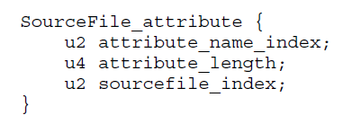
ca | fe | ba | be | 00 | 00 | 00 | 3a | 00 | 14 | 0a | 00 | 02 | 00 | 03 | 07
00 | 04 | 0c | 00 | 05 | 00 | 06 | 01 | 00 | 10 | 6a | 61 | 76 | 61 | 2f | 6c
61 | 6e | 67 | 2f | 4f | 62 | 6a | 65 | 63 | 74 | 01 | 00 | 06 | 3c | 69 | 6e
69 | 74 | 3e | 01 | 00 | 03 | 28 | 29 | 56 | 09 | 00 | 08 | 00 | 09 | 07 | 00
0a | 0c | 00 | 0b | 00 | 0c | 01 | 00 | 04 | 44 | 65 | 6d | 6f | 01 | 00 | 01
6e | 01 | 00 | 01 | 49 | 01 | 00 | 04 | 43 | 6f | 64 | 65 | 01 | 00 | 0f | 4c
69 | 6e | 65 | 4e | 75 | 6d | 62 | 65 | 72 | 54 | 61 | 62 | 6c | 65 | 01 | 00
03 | 61 | 64 | 64 | 01 | 00 | 05 | 28 | 49 | 49 | 29 | 49 | 01 | 00 | 05 | 6d
69 | 6e | 75 | 73 | 01 | 00 | 0a | 53 | 6f | 75 | 72 | 63 | 65 | 46 | 69 | 6c
65 | 01 | 00 | 09 | 44 | 65 | 6d | 6f | 2e | 6a | 61 | 76 | 61 | 00 | 21 | 00
08 | 00 | 02 | 00 | 00 | 00 | 01 | 00 | 02 | 00 | 0b | 00 | 0c | 00 | 00 | 00
03 | 00 | 01 | 00 | 05 | 00 | 06 | 00 | 01 | 00 | 0d | 00 | 00 | 00 | 26 | 00
02 | 00 | 01 | 00 | 00 | 00 | 0a | 2a | b7 | 00 | 01 | 2a | 08 | b5 | 00 | 07
b1 | 00 | 00 | 00 | 01 | 00 | 0e | 00 | 00 | 00 | 0a | 00 | 02 | 00 | 00 | 00
01 | 00 | 04 | 00 | 02 | 00 | 02 | 00 | 0f | 00 | 10 | 00 | 01 | 00 | 0d | 00
00 | 00 | 22 | 00 | 02 | 00 | 04 | 00 | 00 | 00 | 06 | 1b | 1c | 60 | 3e | 1d
ac | 00 | 00 | 00 | 01 | 00 | 0e | 00 | 00 | 00 | 0a | 00 | 02 | 00 | 00 | 00
05 | 00 | 04 | 00 | 06 | 00 | 04 | 00 | 11 | 00 | 10 | 00 | 01 | 00 | 0d | 00
00 | 00 | 22 | 00 | 02 | 00 | 04 | 00 | 00 | 00 | 06 | 1b | 1c | 64 | 3e | 1d
ac | 00 | 00 | 00 | 01 | 00 | 0e | 00 | 00 | 00 | 0a | 00 | 02 | 00 | 00 | 00
0a | 00 | 04 | 00 | 0b | 00 | 01 | 00 | 12 | 00 | 00 | 00 | 02 | 00 | 13 | 0a
Attributes
Attribute Name Index: 0x0012 = 18
#18 = Utf8 SourceFile
Attribute Length: 0x00000002 = 2
Sourcefile Index:0x0013 = 19
#19 = Utf8 Demo.java

